Slide 1
Entrepreneurial Lab (BMME078) Block 4 Luca Berchicci, PhD

Slide 2
Reading a case study about venture creation

Slide 3
Venture creation is messy!

Slide 4
Experience the entrepreneurial process!

Slide 5
Basic Idea
Take what you learn from opportunity creation, Ent. skillset, startup & growth, mix it and apply it in your own business journey
Together with your team, you will choose a business idea to work on and, as a team, you will develop it in the next 6 weeks.
Students from other programs will join too, thus you can create a diverse team (yeah!!)

Slide 6
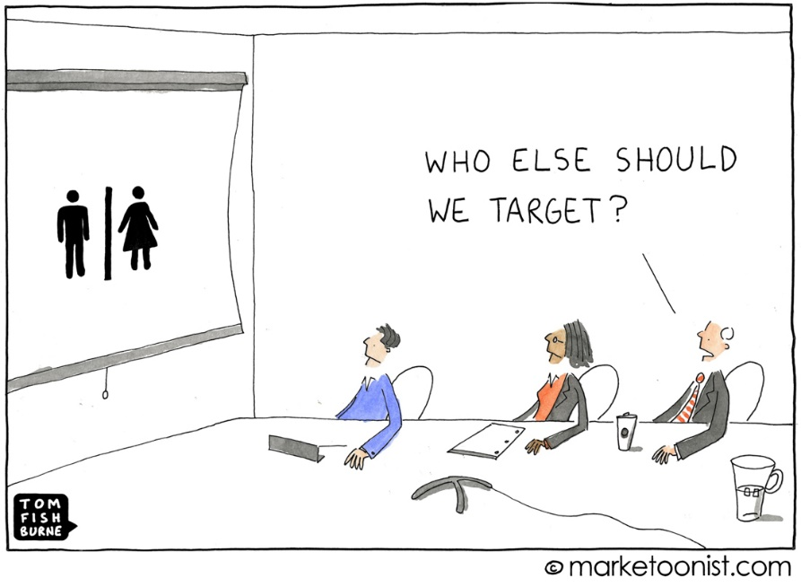
Course Content
The course content is designed to facilitate your team to validate your business idea: define a business idea, develop a business model, and test the assumptions of (some part of) the business model

Slide 7
Approach: the scientific method
It’s a frame of mind—a mode of thinking.
We move into scientist mode when we’re searching for the truth: we run experiments to test hypotheses and discover knowledge.
The intuition: entrepreneurs should behave like scientists and the entrepreneurial process should be grounded on the application of the scientific method
Your business strategy is a theory
Customer interviews help to develop hypotheses, and your minimum viable product and prototype are experiments to test those hypotheses.
Your task is to rigorously measure the results and make decisions based on whether their hypotheses are supported or refuted

Slide 8
Ideation -assumptions- test - pivoting
VP 1
Test its assumptions
VP 2
Test its assumptions
VP 3

Slide 9
Teaching style
Flipped-classroom
Hand-on experiential learning
Get-out-of-the-building teaching (you will learn more outside than inside the ‘virtual’ building)
Workshops

Slide 10
Challenges during the course
Challenge 1: Business model and market analysis
Challenge 2: Value Proposition
Challenge 3: Prototyping
Challenge 4: Social network
Challenge 5: Financial model

Slide 11
Grading
Final business idea presentation (15% of the course grade)
Team assignment graded by a jury
Weekly blogs (10% of the course grade)
Final report (15% of the course grade)
Team Challenges (40% of the course grade)
Team assignment graded by me
Individual differentiation: your team decide how much each member deserves
Participation (20% of the course grade based on quizzes during class)

Slide 12
