Slide 1
Corporate Finance for
Long-Term Value
Chapter 8: Valuing bonds

Slide 2
Chapter 8: Valuing bonds
Part 3: Valuation of companies

Slide 3
The BIG Picture
Corporate bonds are a key financing tool for companies
Traditional valuation
Bond investors are more focused on downside protection
Government bond yield (benchmark) + spread for credit & liquidity risk = corporate bond yield
New valuation
Integrate social and environmental factors into credit risk
Emergence of green bonds and sustainability-linked bonds

Slide 4
The bond market
Bonds are certificates of debt that promise payment of the borrowed amount plus interest by a specified future date
Bonds are issued by:
  A government
  A company
  A financial institution
Type of securities | Outstanding (in trillions of USD)
Equity markets | 112.1
- Public equity |  | 105.8
- Private equity |  | 6.3
Bond markets | 123.4
- Government bonds |  | 62.8
- Corporate bonds |  | 60.6
- Issued by companies |  |  | 17.0
- Issued by financial institutions |  |  | 43.6
Sources: SIFMA (2021); McKinsey (2022); BIS debt securities statistics.

Slide 5
Bond payments
A bond certificate indicates the amounts and dates of all payments (principal + interest) to be made
The maturity date of the bond is the final repayment date, and the time until the maturity date is the term of the bond
Two types of payments made on a bond:
  Promised periodic interest payments, called coupons
  Principal / face value of the bond, to be paid at maturity

Slide 6
Types of bonds
Government / sovereign bonds are issued by national governments (countries)
Corporate bonds are issued by companies or financial institutions
  Secured bonds contain assets as collateral (i.e. mortgage bonds)
  Unsecured bonds have lower seniority / priority
Debt
Private debt
Bonds
(public debt)
Government bonds
Corporate bonds
Secured corporate bonds
Unsecured corporate bonds

Slide 7
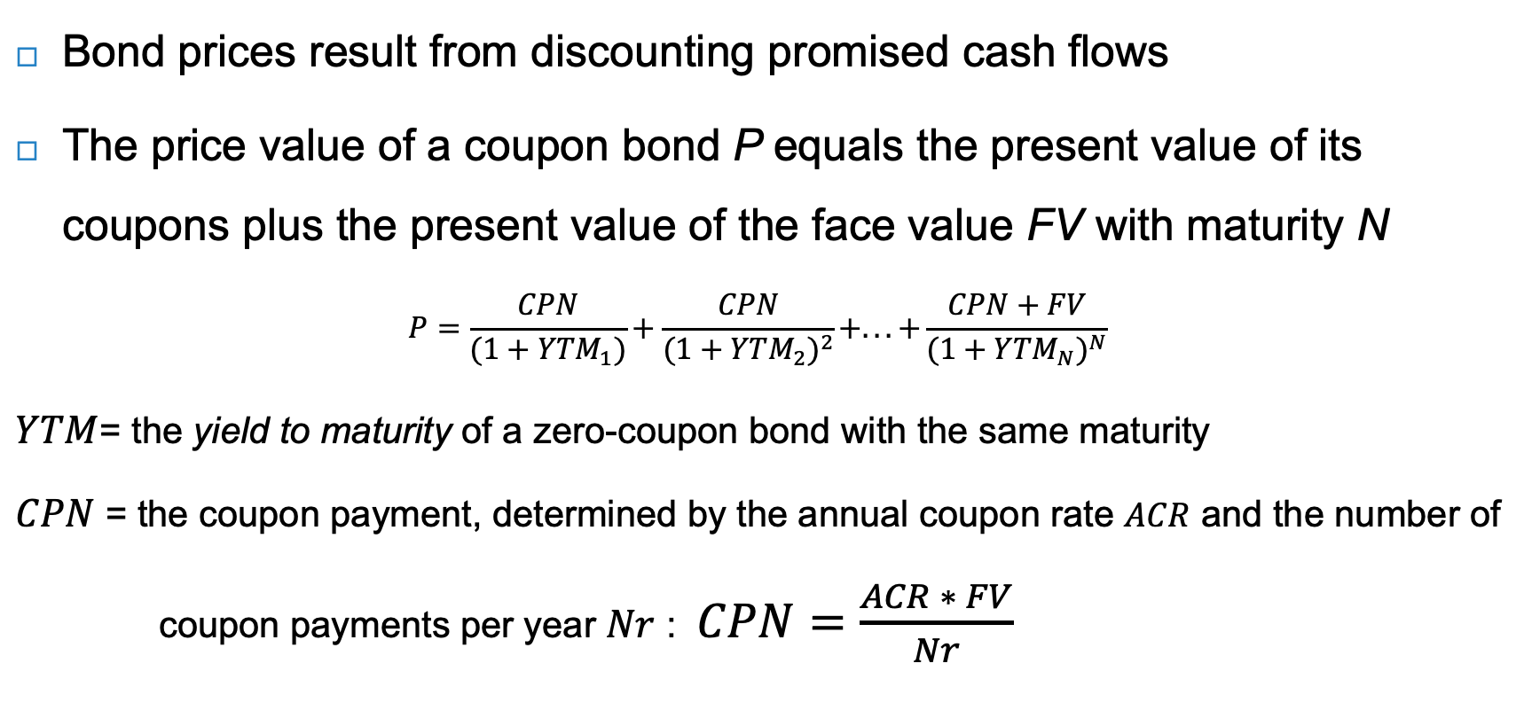
Bond valuation
Bond prices result from discounting promised cash flows
The price value of a coupon bond P equals the present value of its coupons plus the present value of the face value FV with maturity N
$$P=\frac{CPN}{(1+{YTM}_{1})}+\frac{CPN}{(1+{YTM}_{2})^{2}}+...+\frac{CPN+FV}{(1+{YTM}_{N})^{N}}$$
$YTM$= the yield to maturity of a zero-coupon bond with the same maturity
$CPN$ = the coupon payment, determined by the annual coupon rate $ACR$ and the number of
coupon payments per year $Nr$ : $CPN=\frac{ACR ∗ FV}{Nr}$

Slide 8
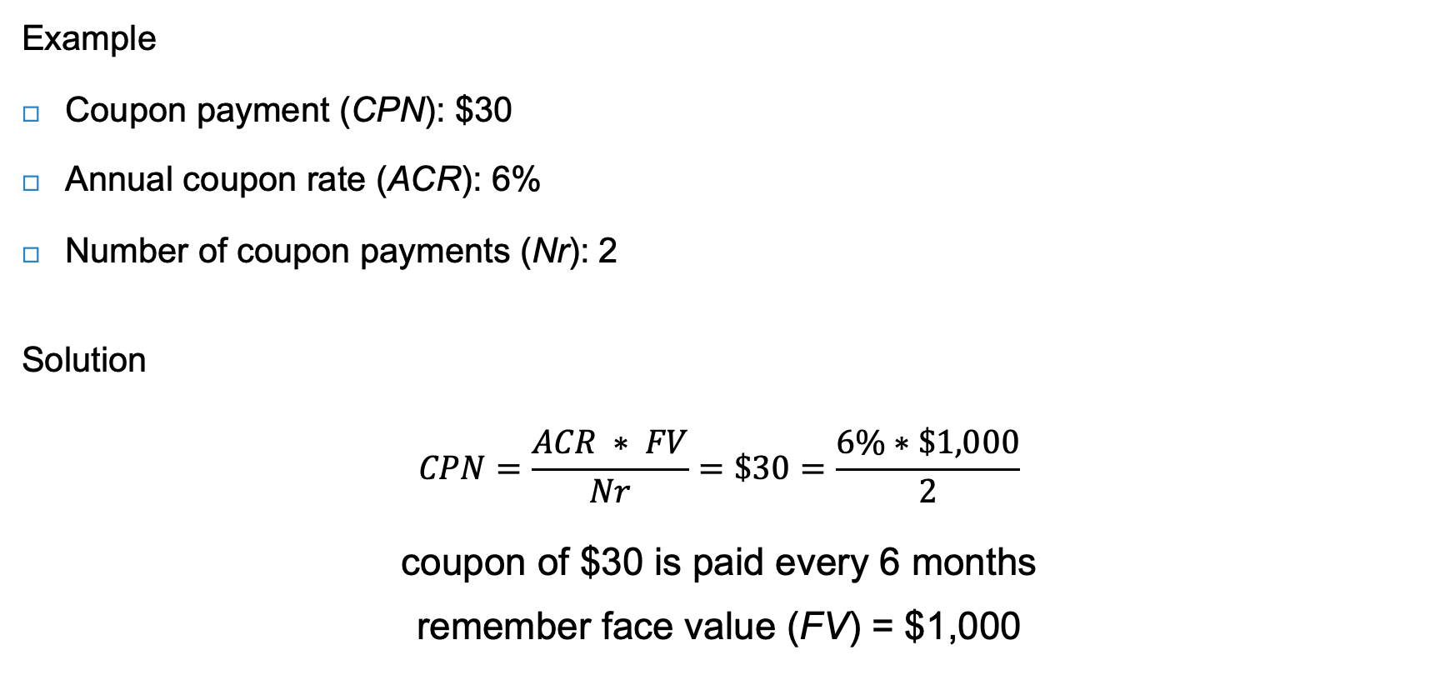
Bond valuation
Example
Coupon payment (CPN): $30
Annual coupon rate (ACR): 6%
Number of coupon payments (Nr): 2
Solution
$$CPN=\frac{ACR ∗ FV}{Nr}=\$30=\frac{6\%∗\$1,000}{2}$$
coupon of $30 is paid every 6 months
remember face value (FV) = $1,000

Slide 9
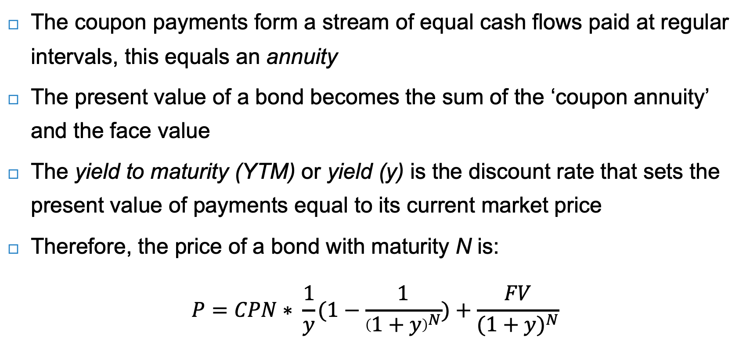
Bond valuation
The coupon payments form a stream of equal cash flows paid at regular intervals, this equals an annuity
The present value of a bond becomes the sum of the ‘coupon annuity’ and the face value
The yield to maturity (YTM) or yield (y) is the discount rate that sets the present value of payments equal to its current market price
Therefore, the price of a bond with maturity N is:
$$P=CPN∗ \frac{1}{y}(1−\frac{1}{{\left(1+y\right)}^{N}})+\frac{FV}{{(1+y)}^{N}}$$

Slide 10
Bond valuation
The relationship between bond yields and bond prices is maintained through market forces:
  As interest rates and bond yields rise, bond prices fall
  And vice versa: As bond yields fall, bond prices increase
  This means bonds can trade at:
    A premium – a price greater than face value
    A discount – a price lower than face value
    Par – a price equal to face value ← this is rare!

Slide 11
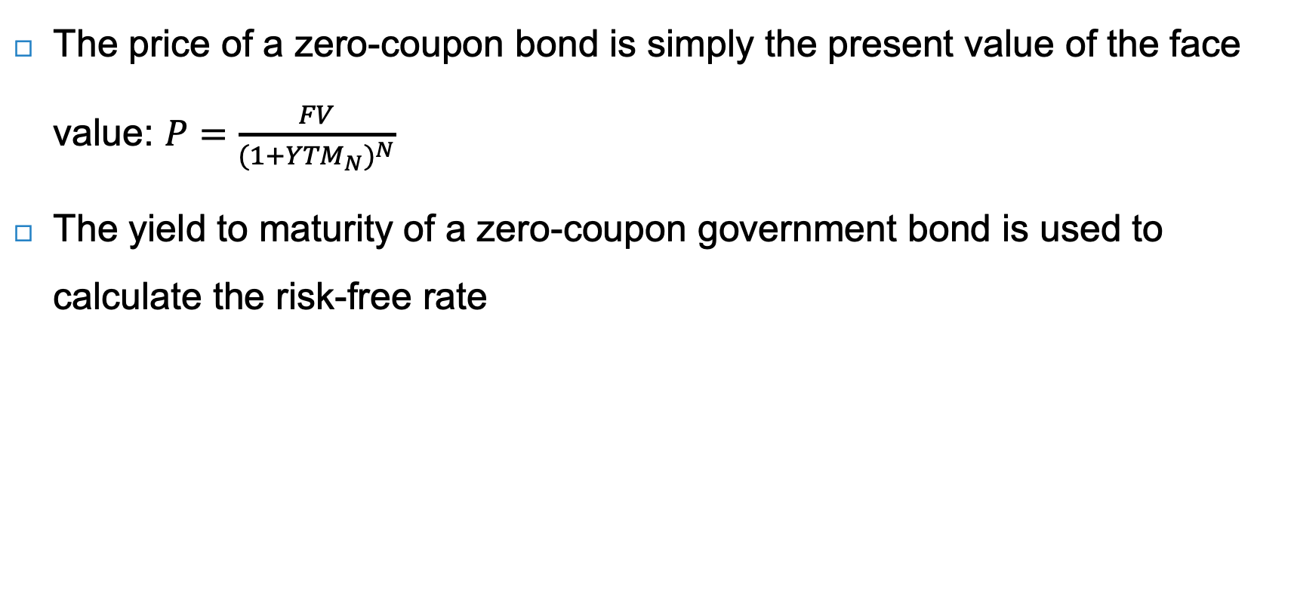
Zero-coupon bonds
The price of a zero-coupon bond is simply the present value of the face value: $P=\frac{FV}{{(1+{YTM}_{N})}^{N}}$
The yield to maturity of a zero-coupon government bond is used to calculate the risk-free rate

Slide 12
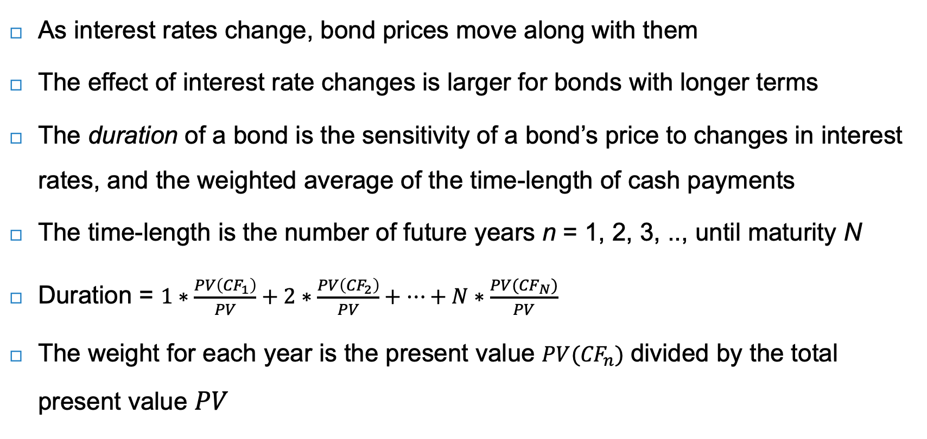
Interest rate changes
As interest rates change, bond prices move along with them
The effect of interest rate changes is larger for bonds with longer terms
The duration of a bond is the sensitivity of a bond’s price to changes in interest rates, and the weighted average of the time-length of cash payments
The time-length is the number of future years n = 1, 2, 3, .., until maturity N
Duration = $1∗\frac{PV\left({CF}_{1}\right)}{PV}+2∗\frac{PV\left({CF}_{2}\right)}{PV}+…+N∗\frac{PV({CF}_{N})}{PV}$
The weight for each year is the present value $PV({CF}_{n})$ divided by the total present value $PV$

Slide 13
Duration
Calculating the duration of 5% six-year bond with a YTM of 4%
Time | 2022 | 2023 | 2024 | 2025 | 2026 | 2027
Year | 1 | 2 | 3 | 4 | 5 | 6
Cash flow | € 50 | € 50 | € 50 | € 50 | € 50 | € 1,050
Discount factor | 0.962 | 0.925 | 0.889 | 0.855 | 0.822 | 0.790
PV(CF_{n}) at 4% | € 48.1 | € 46.2 | € 44.4 | € 42.7 | € 41.1 | € 829.8 | Total PV = | € 1,057.7
Fraction of total value | 0.045 | 0.044 | 0.042 | 0.040 | 0.039 | 0.785 | Total = | 1.0
Year * fraction of total value | 0.045 | 0.087 | 0.126 | 0.162 | 0.194 | 4.708 | Total duration = | 5.3
Duration (5.3 years) is typically close to maturity (6 years), because of large weight of face value
Duration is good measure of interest rate risk of bond, where higher duration reflects higher interest rate risk

Slide 14
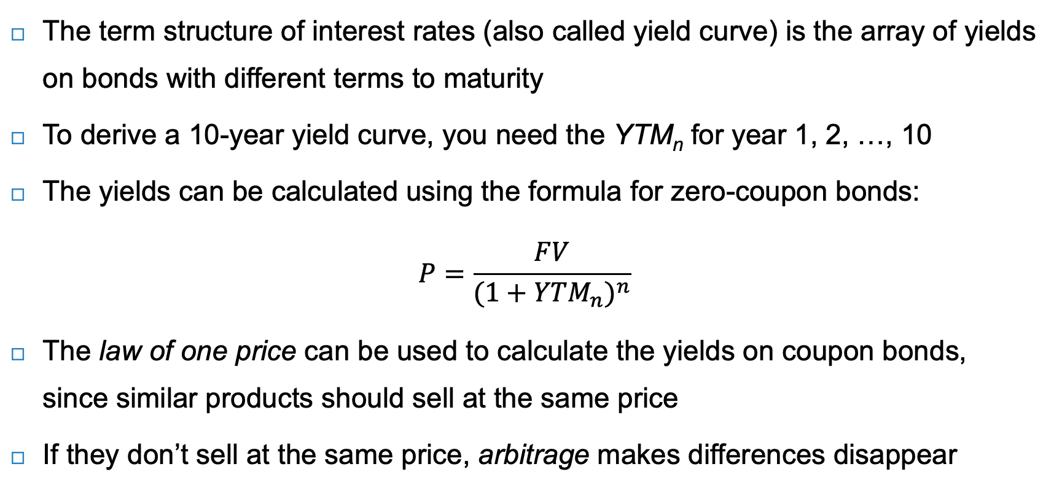
Term structure of interest rates
The term structure of interest rates (also called yield curve) is the array of yields on bonds with different terms to maturity
To derive a 10-year yield curve, you need the YTM_{n} for year 1, 2, …, 10
The yields can be calculated using the formula for zero-coupon bonds:
$$P=\frac{FV}{{(1+{YTM}_{n})}^{n}}$$
The law of one price can be used to calculate the yields on coupon bonds, since similar products should sell at the same price
If they don’t sell at the same price, arbitrage makes differences disappear

Slide 15

Government bond yield
$$P=\frac{FV}{{(1+{YTM}_{n})}^{n}}$$
Government bonds are the safest and most liquid bonds
serve as benchmark
risk-free rate
Source: World Government Bonds

Slide 16
Yields on coupon bonds with the same maturity
 | Year (n) |  |  |  | Bond price (P) | Yield (y)
Maturity | 1 | 2 | 3 | 4
Zero-coupon yield | 2% | 3% | 4% | 5%
Discount factor | 0.98 | 0.94 | 0.89 | 0.82
Bond A (4% coupon)
Payment | € 40 | € 40 | € 40 | € 1,040
PV(CF_{n}) | € 39.22 | € 37.70 | € 35.56 | € 855.61 | € 968.09 | 4.90%
Bond B (6% coupon)
Payment | € 60 | € 60 | € 60 | € 1060
PV(CF_{n}) | € 58.82 | € 56.56 | € 53.34 | € 872.06 | € 1,040.78 | 4.85%
Bond C (0% coupon)
Payment | € 0 | € 0 | € 0 | € 1,000
PV(CF_{n}) | € 0 | € 0 | € 0 | € 822.70 | € 822.70 | 5.00%
Bonds differ in terms of coupon rate, but have the same maturity

Slide 17
Yields on coupon bonds with different maturities
 | Year (n) |  |  |  | Bond price (P) | Yield (y)
Maturity | 1 | 2 | 3 | 4
Zero-coupon yield | 2% | 3% | 4% | 5%
Discount factor | 0.98 | 0.94 | 0.89 | 0.82
Bond D (6% coupon)
Payment | € 60 | € 1,060
PV(CF_{n}) | € 58.82 | € 999.15 |  |  | € 1,057.98 | 2.97%
Bond E (6% coupon)
Payment | € 60 | € 60 | € 1060
PV(CF_{n}) | € 58.82 | € 56.56 | € 942.34 |  | € 1,057.72 | 3.92%
Bond F (6% coupon)
Payment | € 60 | € 60 | € 60 | € 1060
PV(CF_{n}) | € 58.82 | € 56.56 | € 53.34 | € 872.06 | € 1,040.78 | 4.85%
Bonds have the same coupon rate, but differ in terms of maturity

Slide 18
Term structure
Since bonds with higher duration carry more interest rate risk, the yield curve is typically upward sloping
This leads to a positive term spread, which is the spread of yields for bonds with longer maturity over bonds with shorter maturity
This has several explanations:
  The belief that short-term rates will be higher in the future
  Higher exposure of longer-term bonds to changes in interest rates
  Risk of higher inflation in the future

Slide 19
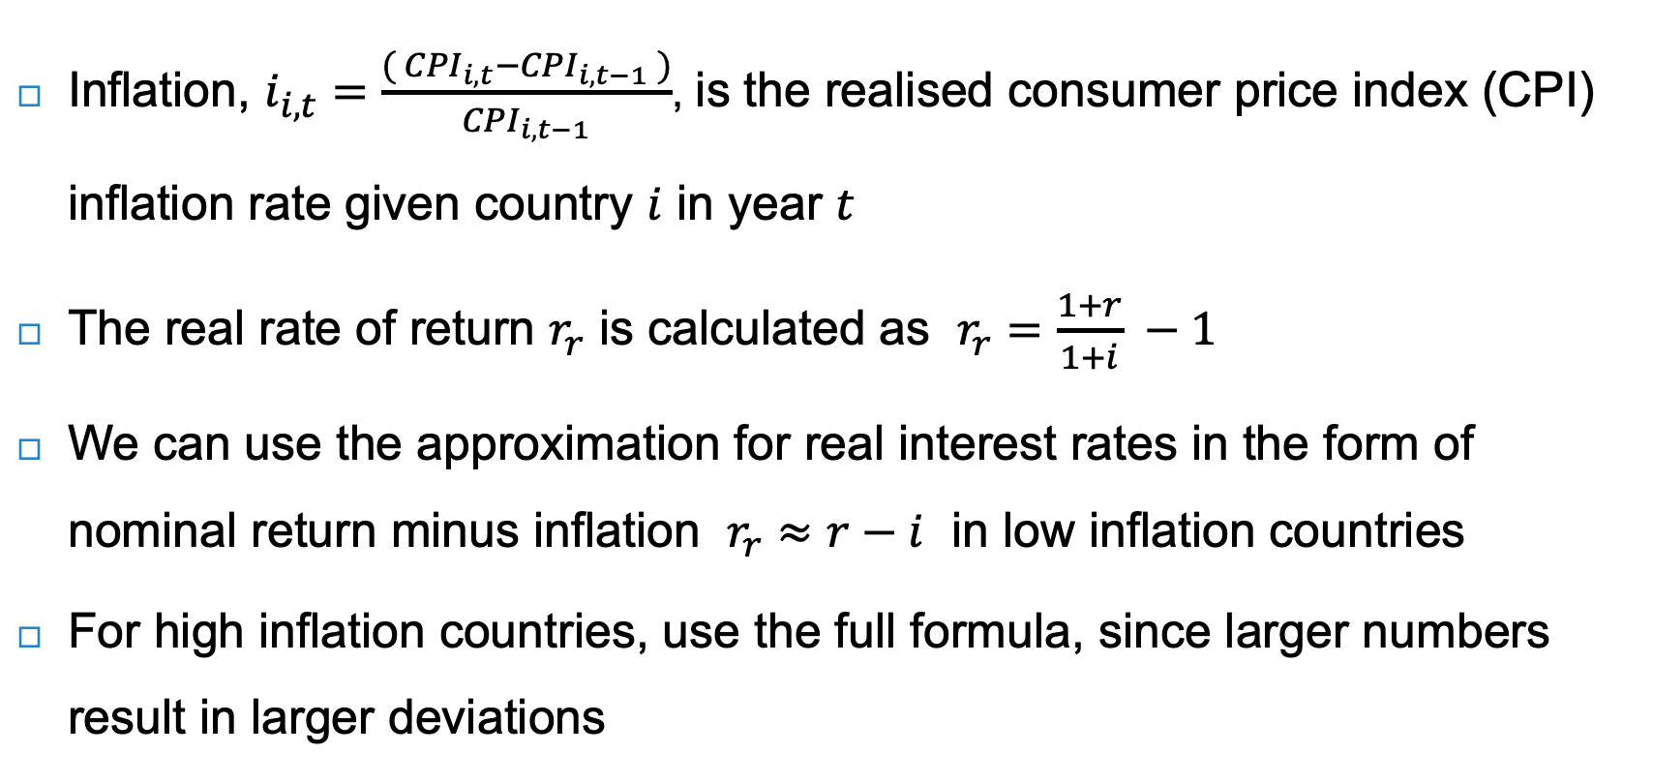
Inflation
Inflation, $i_{i,t}=\frac{{( CPI}_{i,t}−{CPI}_{i,t−1} )}{{CPI}_{i,t−1}}$, is the realised consumer price index (CPI) inflation rate given country $i$ in year $t$
The real rate of return $r_{r}$ is calculated as $r_{r}=\frac{1+r}{1+i} −1$
We can use the approximation for real interest rates in the form of nominal return minus inflation $r_{r}≈r−i$ in low inflation countries
For high inflation countries, use the full formula, since larger numbers result in larger deviations

Slide 20
Drivers of yields on government bonds
Cantor and Packer (1996) find that sovereign borrowing costs can be explained by:
  Per capita income
  GDP growth
  Inflation
Government bonds are typically bought by institutional investors seeking a relatively safe investment
Financial contagion is the spread of market disturbances from one market or country to other markets or countries
  Example: European Sovereign Debt Crisis, originating from Greece in 2009
  External debt
  Level of economic development
  Default history

Slide 21
Government bond yields as risk-free rates
The German bond yield is most creditworthy and can be used as the Euro’s risk-free rate
U.S. government bonds (also called Treasuries) serve as the risk-free rate for the US dollar
Euro-sovereign debt crisis
Source: Bloomberg

Slide 22
Drivers of yields on corporate bonds
Compared to government bonds, corporate bonds tend to carry more serious default and liquidity risks
  Due to lower trading frequencies, higher transaction costs and smaller sizes
Due to the risk of default, the bond’s
expected return (equal to the firm’s
cost of capital) is less than the yield
to maturity YTM

Slide 23
Drivers of yields on corporate bonds
The yield spread is the difference between yields of corporate bonds and yields of government bonds
The higher the default risk, the larger the spread
Maturity | 1 year | 5 year | 10 year | 20 year
AAA corporate bonds | 4.39% | 4.30% | 4.39% | 4.61%
A corporate bonds | 4.68% | 4.66% | 4.92% | 5.26%
AAA Treasuries | 4.07% | 3.85% | 3.65% | 4.04%
AAA corporate yield spread | 0.31% | 0.45% | 0.75% | 0.57%
A corporate yield spread | 0.61% | 0.81% | 1.28% | 1.22%
Source: Bloomberg, as per November 2022

Slide 24
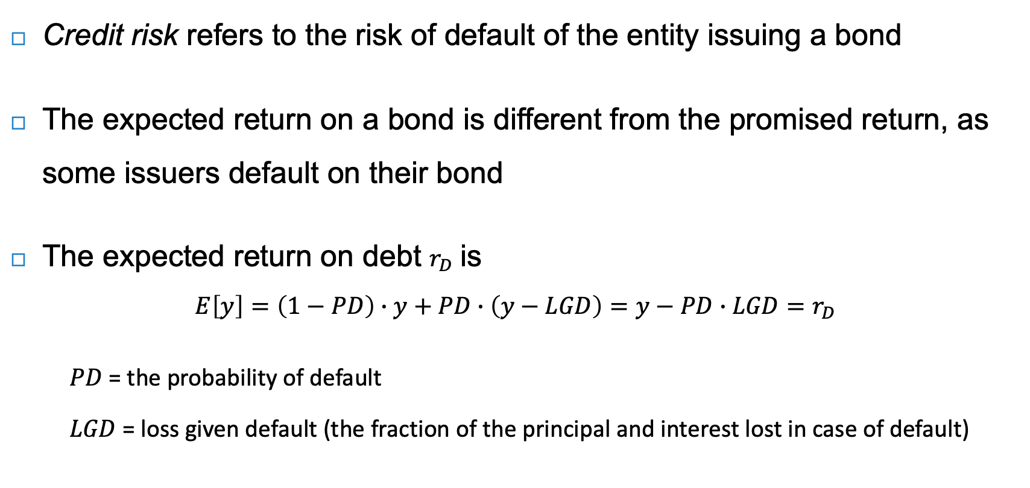
Credit risk
Credit risk refers to the risk of default of the entity issuing a bond
The expected return on a bond is different from the promised return, as some issuers default on their bond
The expected return on debt $r_{D}$ is
$$E\left[y\right]=\left(1−PD\right)∙y+PD∙\left(y−LGD\right)=y−PD∙LGD=r_{D}$$
    $PD$ = the probability of default
    $LGD$ = loss given default (the fraction of the principal and interest lost in case of default)

Slide 25
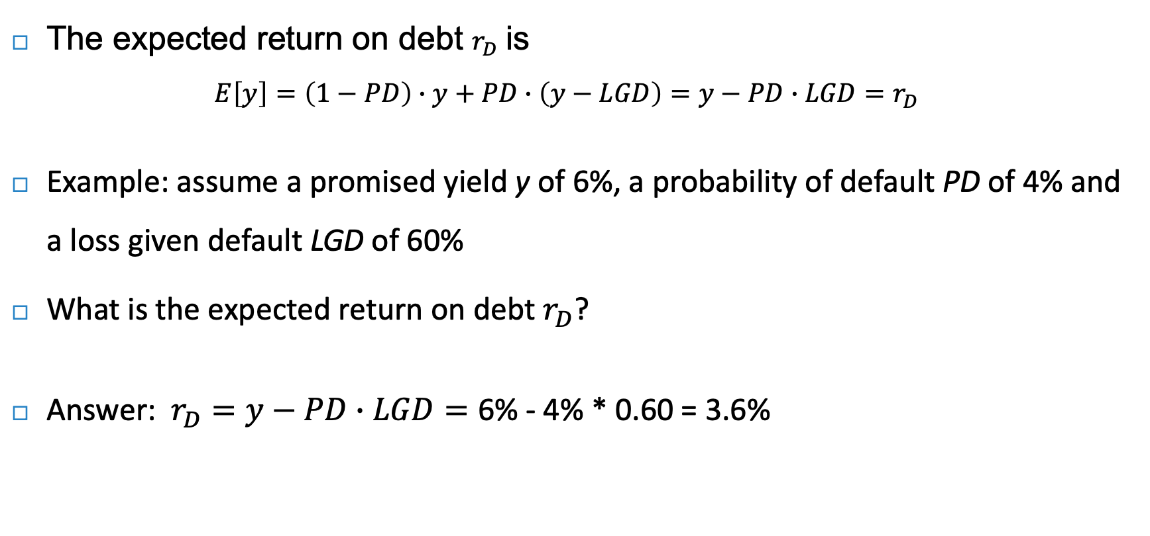
Credit risk - example
The expected return on debt $r_{D}$ is
$$E\left[y\right]=\left(1−PD\right)∙y+PD∙\left(y−LGD\right)=y−PD∙LGD=r_{D}$$
Example: assume a promised yield y of 6%, a probability of default PD of 4% and a loss given default LGD of 60%
What is the expected return on debt $r_{D}$?
Answer: $r_{D}=y−PD∙LGD=\text{6\% − 4\% ∗ 0.60 = 3.6\%}$

Slide 26
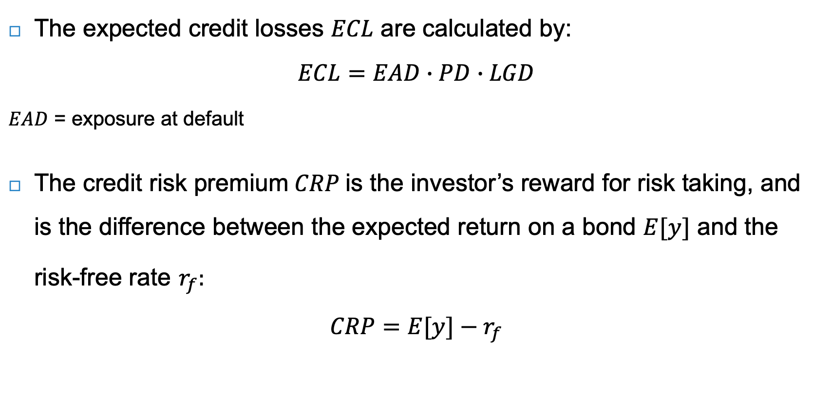
Credit risk
The expected credit losses $ECL$ are calculated by:
$$ECL=EAD∙PD∙LGD$$
$EAD$ = exposure at default
The credit risk premium $CRP$ is the investor’s reward for risk taking, and is the difference between the expected return on a bond $E[y]$ and the risk-free rate $r_{f}:$
$$CRP=E[y]−r_{f}$$

Slide 27
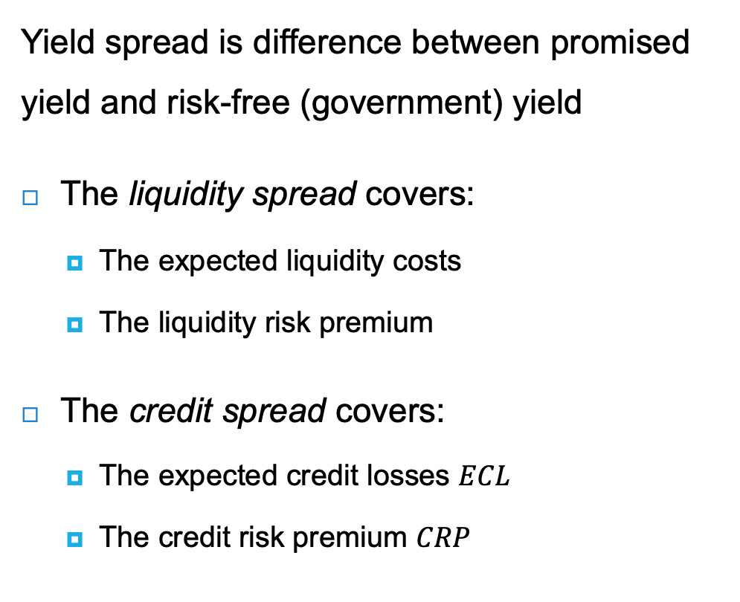
Yield, credit and liquidity spreads
Yield spread is difference between promised yield and risk-free (government) yield
The liquidity spread covers:
  The expected liquidity costs
  The liquidity risk premium
The credit spread covers:
  The expected credit losses $ECL$
  The credit risk premium $CRP$
Corporate bond yield
Expected
liquidity costs
Liquidity spread
Liquidity risk premium
Yield spread
Expected
credit losses
Credit spread
Credit risk premium
Risk-free rate

Slide 28
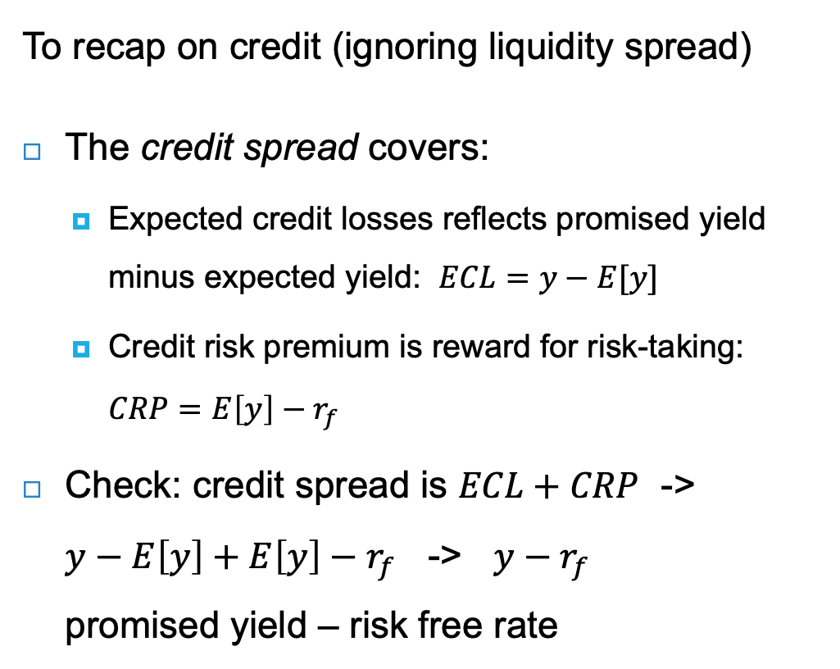
Be very precise on credit definitions
To recap on credit (ignoring liquidity spread)
The credit spread covers:
  Expected credit losses reflects promised yield minus expected yield: $ECL=y−E[y]$
  Credit risk premium is reward for risk-taking: $CRP=E\left[y\right]−r_{f}$
Check: credit spread is $ECL+CRP$ ->
$y−E\left[y\right]+E\left[y\right]−r_{f}$ -> $y−r_{f}$
promised yield – risk free rate
Corporate bond yield
Expected
liquidity costs
Liquidity spread
Liquidity risk premium
Yield spread
Expected
credit losses
Credit spread
Credit risk premium
Risk-free rate

Slide 29
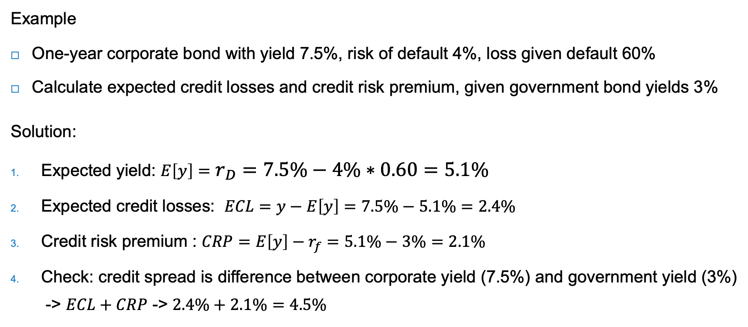
Example
Example
One-year corporate bond with yield 7.5%, risk of default 4%, loss given default 60%
Calculate expected credit losses and credit risk premium, given government bond yields 3%
Solution:
Expected yield: $E\left[y\right]=r_{D}=7.5\%−4\%∗0.60=5.1\%$
Expected credit losses: $ECL=y−E\left[y\right]=7.5\%−5.1\%=2.4\%$
Credit risk premium : $CRP=E\left[y\right]−r_{f}=5.1\%−3\%=2.1\%$
Check: credit spread is difference between corporate yield (7.5%) and government yield (3%)
-> $ECL+CRP$ -> $2.4\%+2.1\%=4.5\%$

Slide 30
Corporate bonds during times of crises
During crises, credit spreads can jump due to higher (perceived) risk of default and/or investor’s ‘flight to safety’
During the 2009 global financial crisis, spreads increased considerably:
Source: Bloomberg

Slide 31
Credit ratings
Rating agency | Moody’s | Standard & Poor’s and Fitch | Long-term average default rate
Type of bonds | Investment grade bonds
 | Aaa | AAA | 0.00%
 | Aa | AA | 0.02%
 | A | A | 0.05%
 | Baa | BBB | 0.16%
Type of bonds | Junk or high yield bonds
 | Ba | BB | 0.61%
 | B | B | 3.33%
 | Caa | CCC | 27.08%
 | Ca | CC
 | C | C

Slide 32
Agency costs
Owning the equity of a company is like having the right to buy the company (an option) paying the face value of debt to the bondholders
The more debt there is, the riskier that right becomes (Merton, 1974)
A benefit for bondholders is that they get paid back first in case of default
Equity holders benefit from volatility (risk), while bondholders suffer from volatility or uncertainty
Myers’ (1977) ‘debt overhang’ problem: if management is aligned with equity holders, it will only attract new capital for projects with high enough returns to leave a residual return for shareholders as well

Slide 33
Liquidity risk
Bonds also face liquidity risk, which is the risk that bonds cannot be sold swiftly
Liquidity is the ease with which an investor can sell or buy a bond
The liquidity spread is the spread between the yield of a bond with high liquidity and a similar bond with less liquidity
The higher liquidity risk of corporate bonds stems from lower trading frequencies and higher transaction costs

Slide 34
Integrating sustainability into bond valuation
Sustainability issues include value relevant issues (inefficiencies) that are not yet properly priced
Compared to equity, the focus in fixed income valuation is much more on risk than on opportunities
Environmental and social exposures can have effects on performance by generating risks that may materialise in future scenarios
  Volkswagen credit default swap (CDS) spread went from 75.5 basis points (bp) to 299.5 after Dieselgate scandal in 2015
  Russian CDS spread went from 200-300bp to 600bp after seizing Crimea from Ukraine in 2014, while Ukrainian CDS spread rose to over 5,000bp

Slide 35
From sustainability to credit risk
Environmental and
social factors
Factors influencing creditworthiness
Credit risk indicators
Climate change
Biodiversity
Energy management
Pollution
Human rights
Health & safety
Gender gap
Etc.
Cash reserves
Profitability
Productivity
Competitive advantage
Cost of capital
Leverage
Intangibles
Etc.
Credit ratings
CDS spreads
Bond yields and prices
Volatility
Default probability
Breach of covenants
Etc.

Slide 36
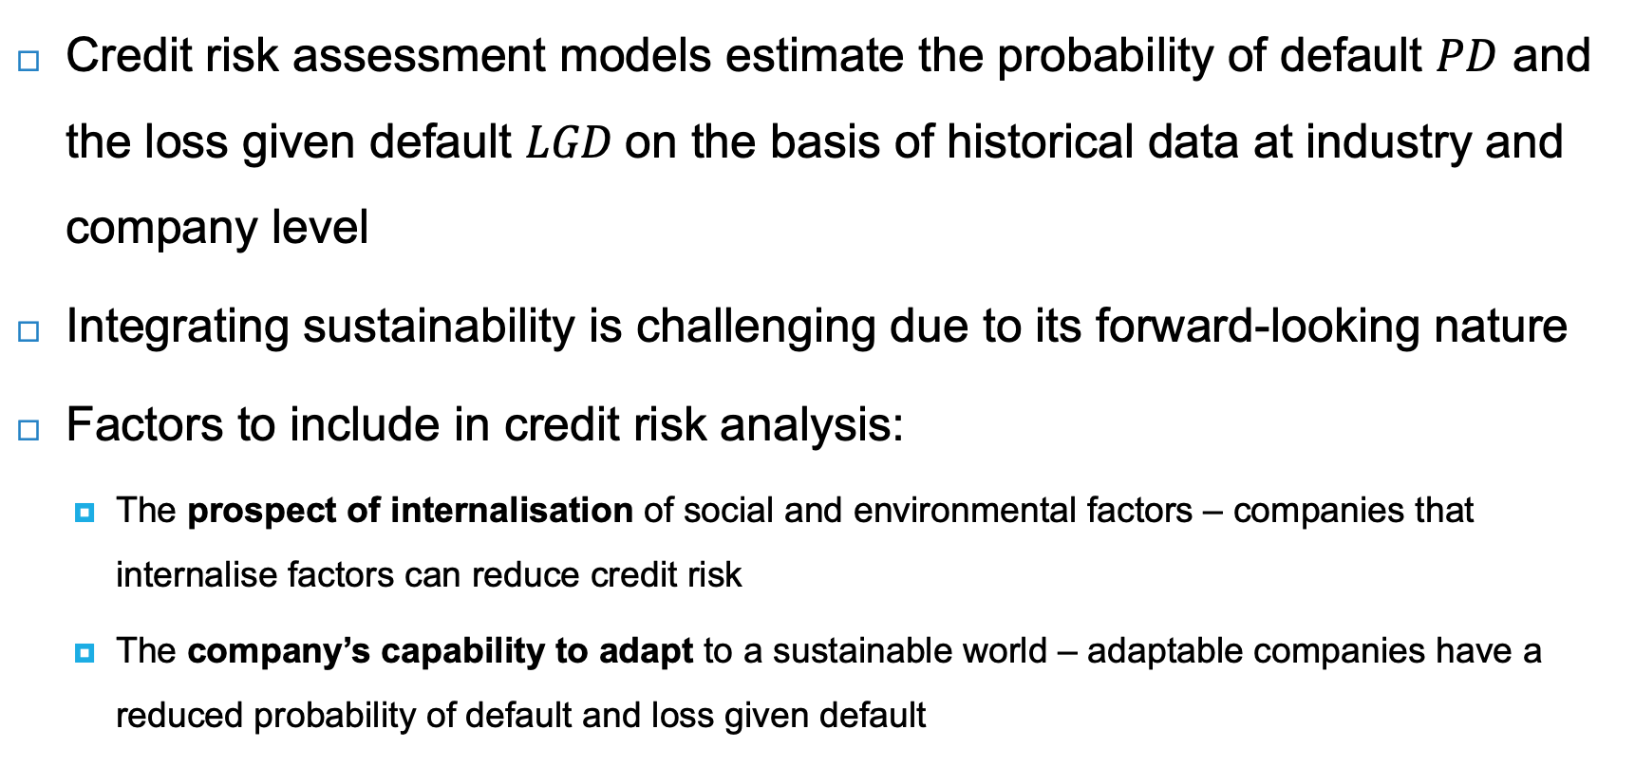
Integrating sustainability into bond valuation
Credit risk assessment models estimate the probability of default $PD$ and the loss given default $LGD$on the basis of historical data at industry and company level
Integrating sustainability is challenging due to its forward-looking nature
Factors to include in credit risk analysis:
  The prospect of internalisation of social and environmental factors – companies that internalise factors can reduce credit risk
  The company’s capability to adapt to a sustainable world – adaptable companies have a reduced probability of default and loss given default

Slide 37
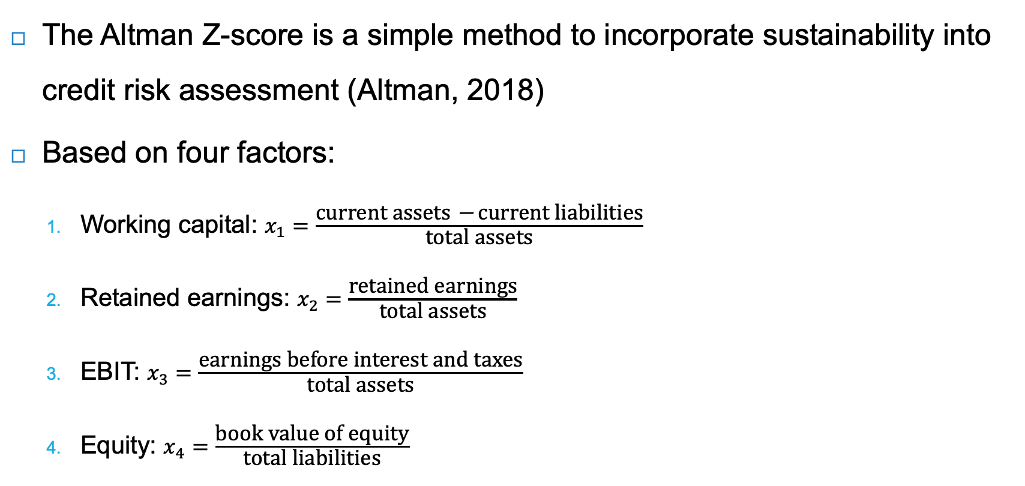
Altman Z-score
The Altman Z-score is a simple method to incorporate sustainability into credit risk assessment (Altman, 2018)
Based on four factors:
  Working capital: $x_{1}=\frac{\text{current} \text{assets} \text{−} \text{current} \text{liabilities}}{\text{total} \text{assets}}$
  Retained earnings: $x_{2}=\frac{\text{retained} \text{earnings}}{\text{total} \text{assets}}$
  EBIT: $x_{3}=\frac{\text{earnings} \text{before} \text{interest} \text{and} \text{taxes}}{\text{total} \text{assets}}$
  Equity: $x_{4}=\frac{\text{book} \text{value} \text{of} \text{equity}}{\text{total} \text{liabilities}}$
Estimate the impact of sustainability on these four factors

Slide 38
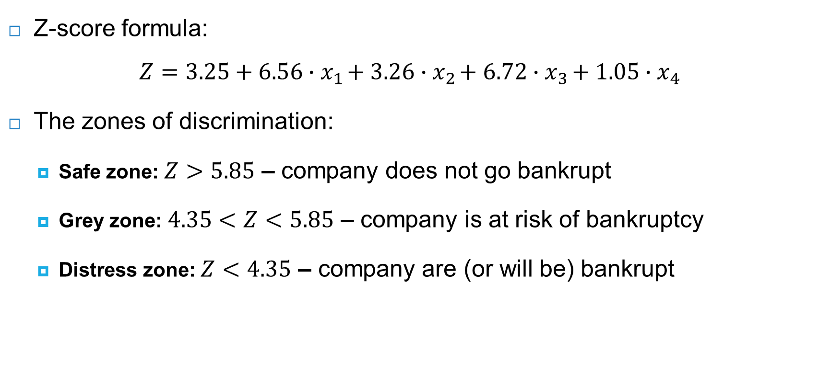
Altman Z-score
Z-score formula:
$$Z=3.25+6.56∙x_{1}+3.26∙x_{2}+6.72∙x_{3}+1.05∙x_{4}$$
The zones of discrimination:
  Safe zone: $Z>5.85$ – company does not go bankrupt
  Grey zone: $4.35<Z<5.85$ – company is at risk of bankruptcy
  Distress zone: $Z<4.35$ – company are (or will be) bankrupt

Slide 39
Evonik’s Z-score
Problem
In 2020, Evonik, a German specialty chemicals company with a large focus on sustainability, had the following current and projected future profile:
What is the impact of Evonik’s sustainability strategy on its default risk?
Factor | 2020 | 2021 | 2022
Working capital | 0.10 | 0.11 | 0.11
Retained earnings | 0.33 | 0.40 | 0.43
EBIT | 0.04 | 0.07 | 0.07
Equity | 0.39 | 0.39 | 0.39

Slide 40

Evonik’s Z-score
Solution
Evonik’s Z-score of 5.66 in 2020 indicates the company is in the grey zone
The improvement in 2021 and 2022 means Evonik moves to the safe zone
$$Z−score=3.25+6.56∙x_{1}+3.26∙x_{2}+6.72∙x_{3}+1.05∙x_{4}$$
Factor | Weight | 2020 | 2021 | 2022
Constant | 1.00 | 3.25 | 3.25 | 3.25
Working capital | 6.56 | 0.10 | 0.11 | 0.11
Retained earnings | 3.26 | 0.33 | 0.40 | 0.43
EBIT | 6.72 | 0.04 | 0.07 | 0.07
Equity | 1.05 | 0.39 | 0.39 | 0.39
Z-score |  | 5.66 | 6.16 | 6.25
Safe zone: $Z>5.85$
Grey zone: $4.35<Z<5.85$
Distress zone: $Z<4.35$

Slide 41
Integrated value calculation
Graph shows IV and its components: FV, EV, SV
High debt and negative values of S and E raise risk of both debt and equity
S and E factors can be internalised and spill over into financial value
Integrated value
FV: enterprise value
Equity
Debt
EV
Components of S x their price
SV
Components of E
x their price

Slide 42
Case-studies integrated value calculation
Case-studies integrated value
Ch6-7 – project valuation
Ch11 – company valuation Inditex
  Make DCF for enterprise value FV
  Make DCF for SV + EV
  Integrate numbers
Ch18 – attempted take-over of Unilever by Kraft Heinz
Inditex IV calculation | Value (Euro billions)
FV (enterprise value) | 79
Positive SV | 283
Negative SV | -137
Negative EV | -183
IV (integrated value) | 42

Slide 43
Green bonds
The purpose of green bonds is to finance environmentally friendly (green) projects
The green bond market has grown exponentially, reaching a global annual issuance of $520 billion in 2021
Issuers include:
  Supranationals (i.e., World Bank, IMF, EIB)
  Agencies
  Governments
  Municipalities
  Corporates
  Financial institutions

Slide 44
Green bonds
Criteria for green bonds, as set out by ICMA (2021):
  Use of proceeds: proceeds are exclusively for green projects, which should be appropriately described in the legal documentation accompanying the security
  Process of project evaluation and selection: the issuer should clearly communicate to investors:
    What the environmental objectives are
    The process by which the issuer determines how the project fits within eligible green project categories
    The related eligibility criteria
  Management of proceeds: the net proceeds of the green bond should be credited to a sub-account, and subsequently tracked and verified
  Reporting: mandatory reporting on the use of the proceeds

Slide 45
EU Taxonomy for sustainable activities
The EU Green Bond Standard specifies that green products should contribute to at least one of six environmental objectives:
  Climate change mitigation
  Climate change adaptation
  Sustainable use and protection of water and marine resources
  Transition to a circular economy
  Pollution prevention and control
  Protection and restoration of biodiversity and ecosystems
A green project should not undermine any of the objectives
The EU Green Bond Standard also requires verification of the allocation of the proceeds to green projects by an external party

Slide 46
Green bonds
Sustainable investors are prepared to pay a green bond premium, resulting in a lower yield – known as the ‘clientele effect’
Green bond premium is the difference in yield between green bonds and perfectly matched reference bonds
Green bond premium typically ranges from 0 to 20bp and averages around 5bp
Benefits for issuers is partly offset by higher issuing and reporting costs, also estimated around 5bp per year
  Green bonds is more about signaling greenness, than saving on borrowing costs

Slide 47
Social bonds
Social bonds need to provide clear social benefits
They are a payment by results contract where an organization (with a social purpose) agrees to deliver outcome on a social project
If the objectives are not reached, investors do not receive a return nor repayment of the principal
Social project categories include, but are not limited to:
  Affordable basic infrastructure
  Access to essential services
  Affordable housing
  Employment generation
  Food security
  Socioeconomic advancement
  Empowerment

Slide 48
Sustainability-linked bonds
Sustainability-linked bonds can be used for the issuer’s general purposes
They incorporate forward-looking sustainability key performance indicators (KPIs) and sustainable performance targets -> expected to be way forward
Improvement in KPIs leads to lower interest rate payments (i.e. a lower yield)
Label | Format
Green bonds | Use of proceeds
Social bonds | Use of proceeds
Sustainability bonds | Use of proceeds
Sustainability-linked bonds | Entity KPI-linked
A combination of green and social projects

Slide 49
Conclusions
The pricing of bonds is relevant for corporate finance for two reasons:
  The yield on government bonds serves as the risk-free rate
  Companies issue bonds to finance their operations
Bond markets are bigger than stock markets, with institutional investors typically holding more bonds than equity
Companies that can better adapt their business model face a lower credit risk
There is innovation in the form of green bonds and social bonds to cater for sustainable investment projects of governments and companies

