Slide 1
Corporate Finance for
Long-Term Value
Chapter 1: The Company within Social and Planetary Boundaries

Slide 2
Chapter 1: The Company within Social and Planetary Boundaries
Part 1: Why corporate finance for long-term value?

Slide 3
The BIG Picture
Economic models were made for an empty world
But we live now in a full world with massive energy and material use and large social inequalities
Solution
United Nations agenda of Social Development Goals
Include social and environmental factors in company valuation
Recognise present and future generations as relevant company stakeholders, alongside shareholders

Slide 4
From pre- to post-industrial revolution
Empty
world
Full
world
Technological advances dependent on fossil fuels & other raw materials
Massive production & consumption
Economic & population growth
Abundance of goods and services from nature
Club of Rome (1973):
Limits to Growth

Slide 5
Sustainable development
UN’s Brundtland Report (1987):
  “"...the environment is where we live; and development is what we all do in attempting to improve our lot within that environment. The two are inseparable."
Sustainable development is “development that meets the needs of the present without compromising the ability of future generations to meet their own needs”

Slide 6
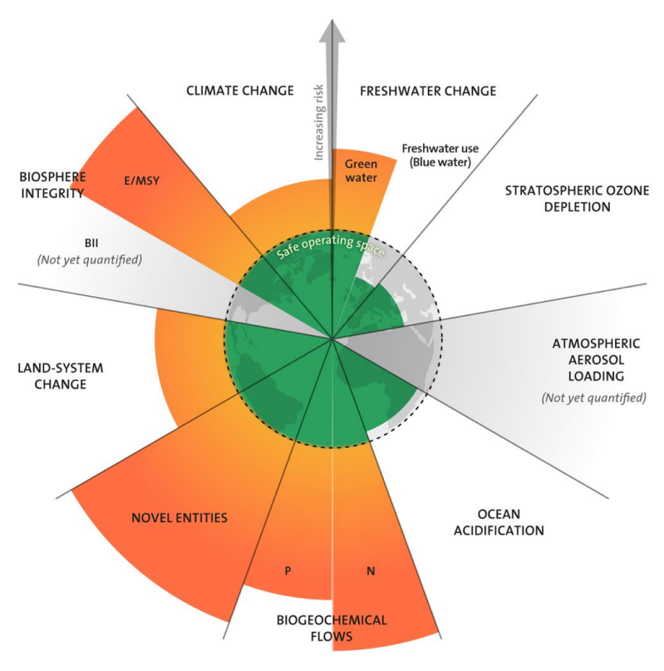
Planetary boundaries
The planetary boundaries framework of Steffen et al. (2015) defines a safe operating space for humanity within the boundaries of nine productive ecological capacities of the planet
The planetary boundary lies at the intersection of the green and orange zones

Slide 7
Social foundations
Kate Raworth defines the social foundations as the social priorities, grouped into three clusters, focused on enabling people to be:
  Well: through food security, adequate income, improved water and sanitation, housing and healthcare;
  Productive: through education, decent work and modern energy services; and
  Empowered: through networks, gender equality, social equity, political voice and peace and justice
UN’s Universal Declaration of Human Rights:
  “recognition of the inherent dignity and of the equal and inalienable rights of all members of the human family is the foundation of freedom, justice and peace in the world”

Slide 8
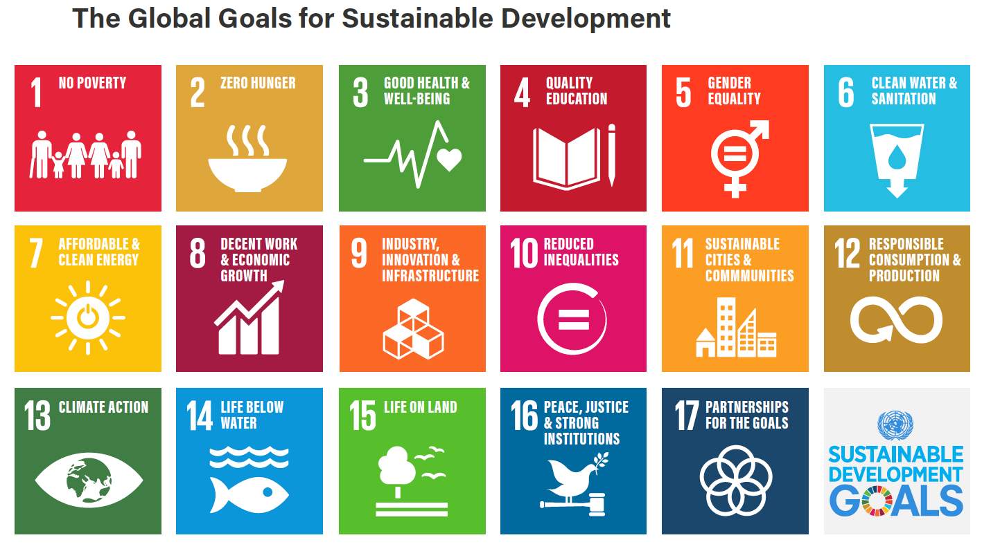
Sustainable Development Goals

Slide 9
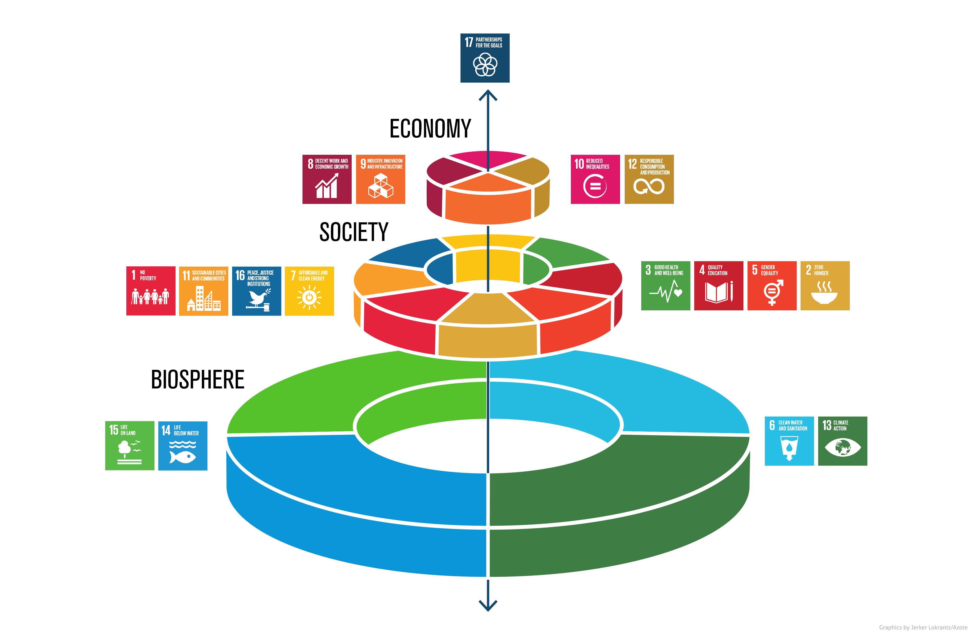
SDGs at different levels
Overall Goal
  SDG 17
Economic Goals
  SDG 8, 9, 10 and 12
Societal Goals
  SDG 1, 2, 3, 4, 5, 7, 11 and 16
Environmental Goals
  SDG 6, 13, 14, 15

Slide 10
Systems perspective
Assume an integrated social-ecological system perspective
The process of sustainable development = embedded cycles with adaptive capacity (Holling, 2001)
  Resilience of the system to deal with unpredictable shocks
  Ecosystem management via incremental increases in efficiency does not work
  For transformation, ecosystem management must build and maintain ecological resistance as well as social flexibility to cope, innovate and adapt

Slide 11
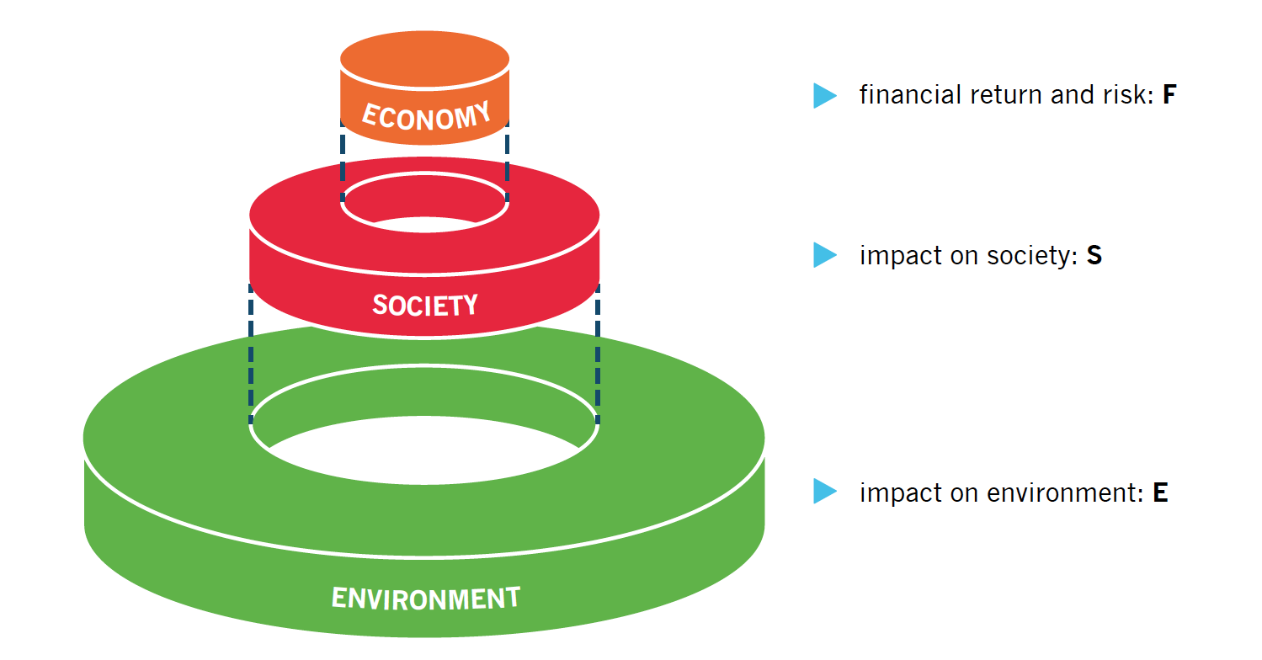
Corporate governance
Shareholder model
  Companies should maximise shareholder value (F)
Stakeholder model
  Companies should act in the interest of financial (F) as well as social (S) stakeholders and optimise stakeholder value
Integrated model
  Companies should optimise integrated value, which combines financial (F), social (S) and environmental (E) value

Slide 12
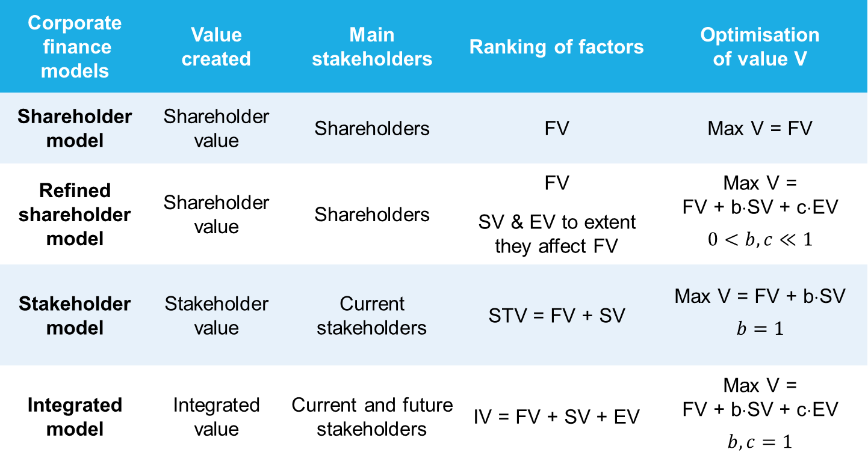
Framework for Sustainable Finance
Corporate finance models | Value created | Main stakeholders | Ranking of factors | Optimisation of value V
Shareholder model | Shareholder value | Shareholders | FV | Max V = FV
Refined shareholder model | Shareholder value | Shareholders | FV SV & EV to extent they affect FV | Max V = FV + b⋅SV + c⋅EV $$0<b,c≪1$$
Stakeholder model | Stakeholder value | Current stakeholders | STV = FV + SV | Max V = FV + b⋅SV $$b=1$$
Integrated model | Integrated value | Current and future stakeholders | IV = FV + SV + EV | Max V = FV + b⋅SV + c⋅EV $$b,c=1$$

Slide 13
The Integrated Model
Integrated value
Integrated model
Stakeholder value
Stakeholder model
Environmental value
Financial value
Shareholder model
Social value
SV
EV
FV

Slide 14
Overview of the Company

Slide 15
Relevance of Integrated Value
Integrated value is relevant for companies in the following ways:
  Taking investment decisions;
  Measuring and reporting performance;
  Conducting risk management;
  Developing incentives;
  Taking structural decisions: capital structure, payouts, M&As, etc.

Slide 16
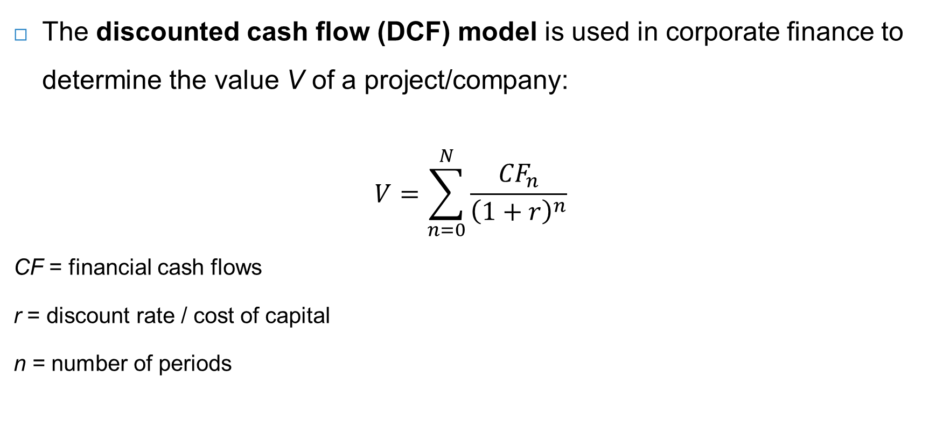
The discounted cash flow (DCF) model
The discounted cash flow (DCF) model is used in corporate finance to determine the value V of a project/company:
$$V=\sum_{n=0}^{N}{\frac{{CF}_{n}}{{\left(1+r\right)}^{n}}}$$
CF = financial cash flows
r = discount rate / cost of capital
n = number of periods

Slide 17
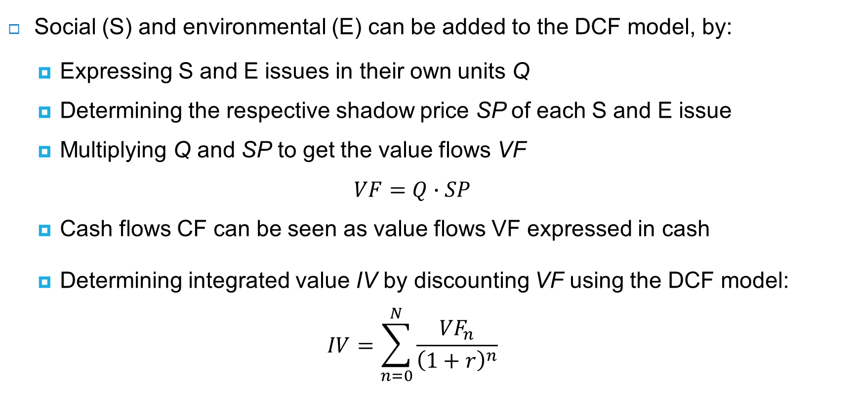
Integration of S and E in DCF model
Social (S) and environmental (E) can be added to the DCF model, by:
  Expressing S and E issues in their own units Q
  Determining the respective shadow price SP of each S and E issue
  Multiplying Q and SP to get the value flows VF
  $$VF=Q∙SP$$
  Cash flows CF can be seen as value flows VF expressed in cash
  Determining integrated value IV by discounting VF using the DCF model:
  $$IV=\sum_{n=0}^{N}{\frac{{VF}_{n}}{{\left(1+r\right)}^{n}}}$$

Slide 18
Expected effect of S and E on value
Value flows
  Companies that create FV at the expense of SV or EV will be affected with lower FV when internalisation occurs
  Internalisation means that the burdens of externalities are increasingly shifted back from society to the companies (in the long term)
Cost of capital
  The cost of capital increases with social and environmental externalities (because of a risk premium) and decreases with positive social and environmental impact (because of reduced risk)

Slide 19
Expected effect of S and E on value
Value effect
  For positive S and/or E impacts, higher value flows (in the numerator) and a lower cost of capital (in the denominator) are expected to produce higher company value in the long term
  Vice versa for negative impacts
So, companies with a positive impact are likely to produce long-term value
The challenge lies in trade-offs across time and between types of value, which can interact in numerous ways

Slide 20
Conclusions
Economic growth in the last century created social and environmental challenges
Sustainability means that current and future generations have the resources needed without stressing the Earth system processes
Corporate finance has the potential to move from finance as a goal (shareholder value) to finance as a means towards integrated value creation
Finance is about anticipating potential catastrophic events and incorporating expectations in today’s valuations for investment decisions

