Slide 1
Corporate Finance for
Long-Term Value
Chapter 12: Risk-return analysis

Slide 2
Chapter 12: Risk-return analysis
Part 4: Risk, return and impact

Slide 3
The BIG Picture
How to analyse risk and return profiles for all types of capital?
Methods
Finance uses several tools (volatility, correlation, diversification) to calculate risk return of individual assets, asset classes and asset portfolios
Key insight is to split between systematic risk (which is not diversifiable and priced) and idiosyncratic risk (which is firm-specific and is not priced)
Social and environmental risk are increasingly seen as sources of systematic risk
Most tools are backward-looking using historical data
Forward-looking measures (scenario analysis, real options) are needed to include new risks, like climate risk

Slide 4
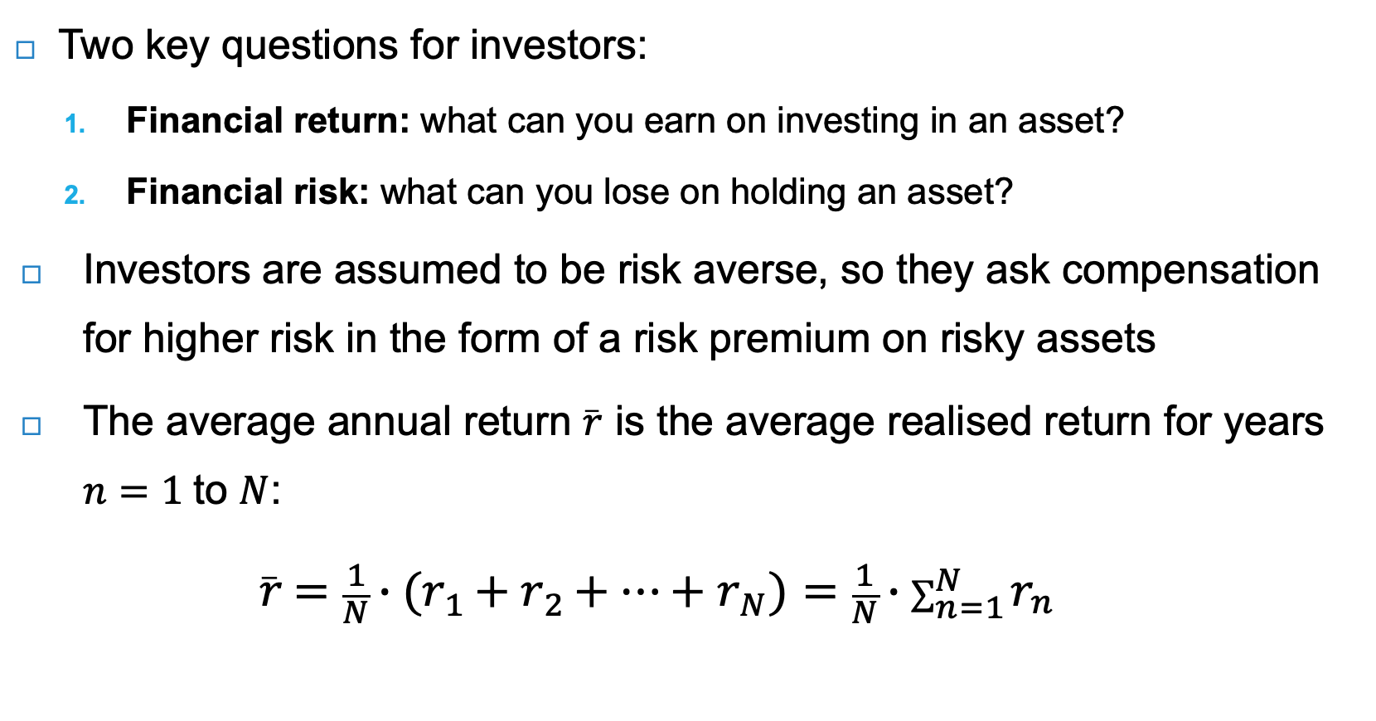
Historical financial risk and return
Two key questions for investors:
  Financial return: what can you earn on investing in an asset?
  Financial risk: what can you lose on holding an asset?
Investors are assumed to be risk averse, so they ask compensation for higher risk in the form of a risk premium on risky assets
The average annual return $\overline{r}$ is the average realised return for years $n=1$to $N$:
$\overline{r}=\frac{1}{N}∙(r_{1}+r_{2}+…+r_{N})=\frac{1}{N}∙\sum_{n=1}^{N}{r_{n}}$

Slide 5
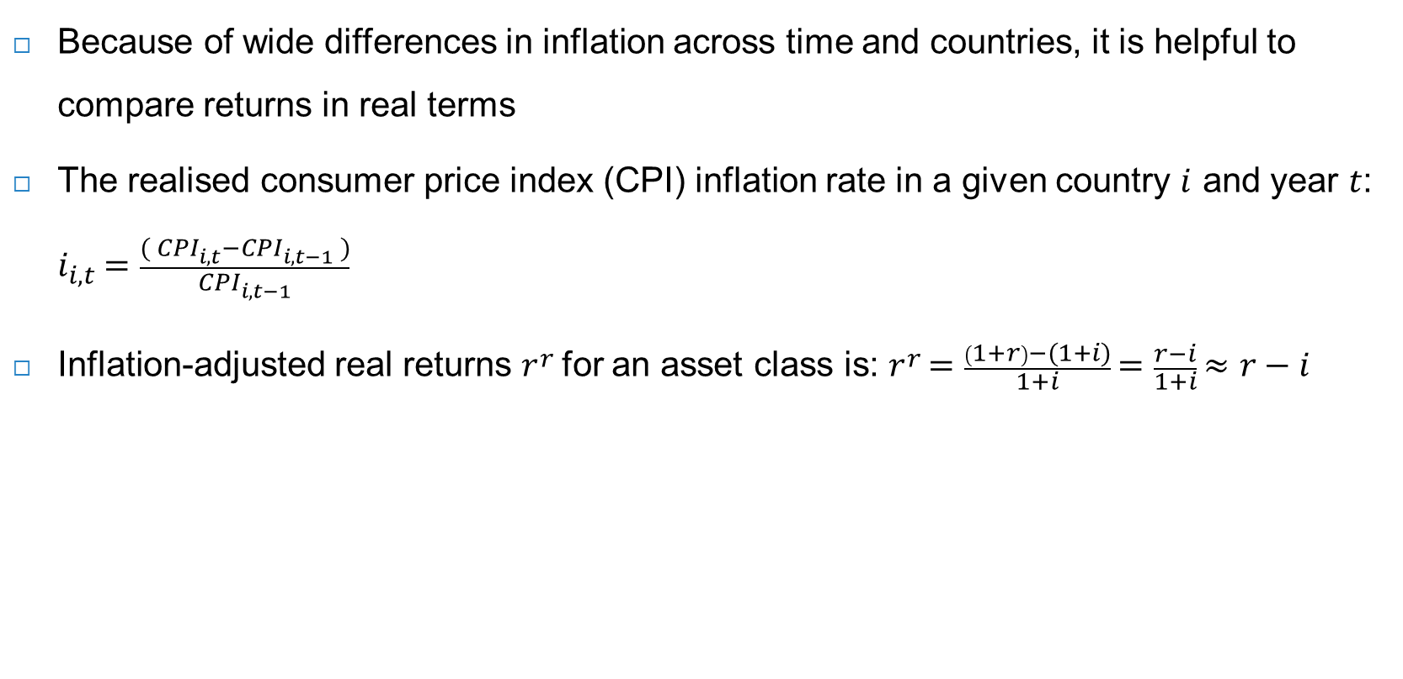
Real returns
Because of wide differences in inflation across time and countries, it is helpful to compare returns in real terms
The realised consumer price index (CPI) inflation rate in a given country $i$ and year $t$: $i_{i,t}=\frac{{( CPI}_{i,t}−{CPI}_{i,t−1} )}{{CPI}_{i,t−1}}$
Inflation-adjusted real returns $r^{r}$for an asset class is: $r^{r}=\frac{\left(1+r\right)−(1+i)}{1+i}=\frac{r−i}{1+i}≈r−i$
Asset class | Average nominal returns | Average real returns | Decadal moving average real returns
Treasury bills | 4.6% | 1.0% | -5% to +6%
Government bonds | 6.1% | 2.5% | -7% to +8%
Equities | 10.7% | 6.9% | -4% to +15%
Risk premium (relative to bills) | 6% | 6% | 0% to 13%
Risk premium (relative to bonds) | 4.5% | 4.5% | 0% to 13%
Global average annual returns from 1870 to 2015 (in 16 countries). Source: Jorda, et al. (2019)

Slide 6
Equity risk premium
The aggregate picture hides significant variation within and between asset classes due to differing risk profiles
Dimson, Marsh and Staunton (2021) find significant variation in equity risk premiums over the 1900-2020 period
Equity risk premiums (relative to bills) from 1900 to 2020 (for 21 countries). Source: data from Dimson, Marsh and Staunton (2002 and 2021)

Slide 7

Equity returns
The total annual return on a financial asset r can be divided into two components:
  The capital gain from the change in the asset price $P$
  A yield component $y$, that reflects the cash-flow return on an investment (e.g. dividend yield)
Total return: $r_{t+1}=\frac{P_{t+1}−P_{t}}{P_{t}}+ y_{t}$
Insights:
For the total return of equities both the capital gain and dividend income are important
More recent returns (from 1950 to 2015) are higher than over the full sample period (1870-2015)
Real returns on equities and government bonds have been relatively high until the 1990s
Only current returns in the low interest environment from 2015 to 2021 have been very low: 3% for equities and -0.5% for government bonds
Time period | Equity
 | Real capital gain | Dividend income | Real total return
Full sample | 2.8% | 4.1% | 6.8%
Post-1950 | 4.7% | 3.8% | 8.4%
Equity returns from 1870 to 2015. Source: Jorda, et al. (2019)

Slide 8
Bill rate (= short-term interest rate)
Historical series show that returns can turn negative during wars and times of crisis
The Treasury bill rate, which is a proxy for the risk-free rate, averages about 1%
  -4% during WWI in the 1910s
  +6% post WWI in the 1920s
  -5% during WWII in the 1940s
  +3% in the 1980s
  0% in 2015

Slide 9
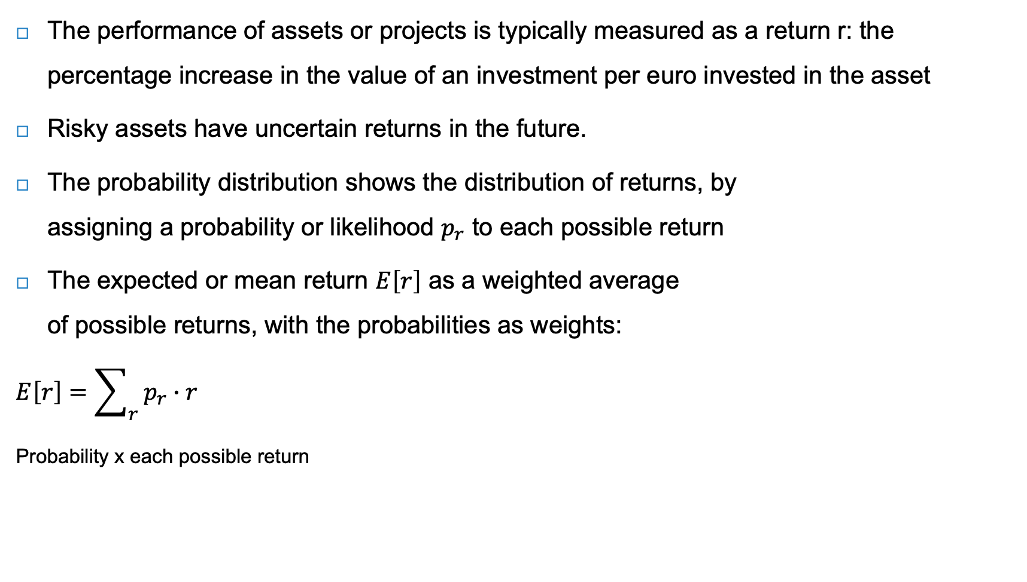
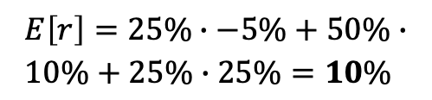
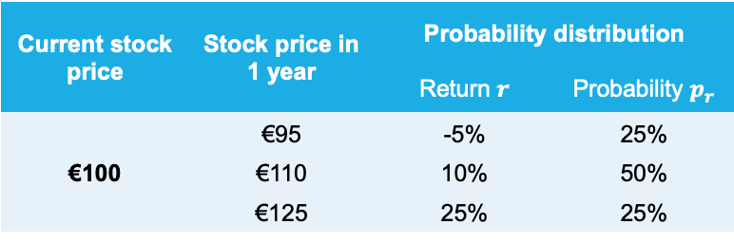
Expected return
The performance of assets or projects is typically measured as a return r: the percentage increase in the value of an investment per euro invested in the asset
Risky assets have uncertain returns in the future.
The probability distribution shows the distribution of returns, by
assigning a probability or likelihood $p_{r}$ to each possible return
The expected or mean return $Ε\left[r\right]$ as a weighted average
of possible returns, with the probabilities as weights:
$$Ε\left[r\right]=\sum_{r}{{ p}_{r}}∙r$$
Probability x each possible return
Current stock price | Stock price in 1 year | Probability distribution
 |  | Return $r$ | Probability $p_{r}$
€100 | €95 | -5% | 25%
 | €110 | 10% | 50%
 | €125 | 25% | 25%
$$Ε\left[r\right]=25\%∙−5\%+50\%∙ \\ 10\%+25\%∙25\%=10\%$$

Slide 10
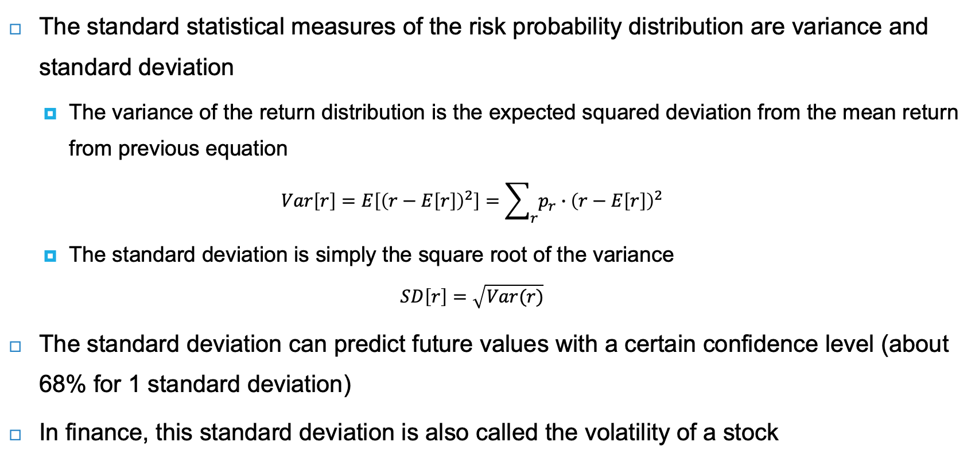
Variance and standard deviation
The standard statistical measures of the risk probability distribution are variance and standard deviation
  The variance of the return distribution is the expected squared deviation from the mean return from previous equation
  $$Var\left[r\right]=E\left[{\left(r−E\left[r\right]\right)}^{2}\right]=\sum_{r}{p_{r}}∙{\left(r−E\left[r\right]\right)}^{2}$$
  The standard deviation is simply the square root of the variance
  $$SD\left[r\right]=\sqrt{Var(r)}$$
The standard deviation can predict future values with a certain confidence level (about 68% for 1 standard deviation)
In finance, this standard deviation is also called the volatility of a stock

Slide 11
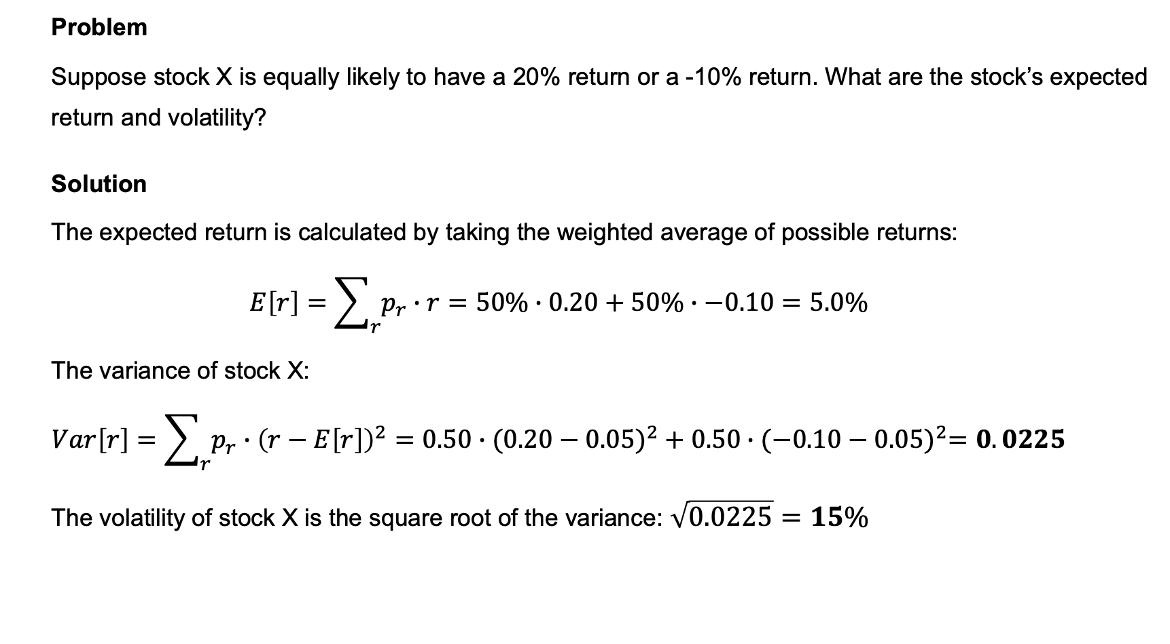
Calculating variance and volatility
  Problem
  Suppose stock X is equally likely to have a 20% return or a -10% return. What are the stock’s expected return and volatility?
  Solution
  The expected return is calculated by taking the weighted average of possible returns:
  $$Ε\left[r\right]=\sum_{r}{p_{r}}∙r=50\%∙0.20+50\%∙−0.10=5.0\%$$
  The variance of stock X:
  $$Var\left[r\right]=\sum_{r}{p_{r}}∙{\left(r−E\left[r\right]\right)}^{2}=0.50∙({0.20−0.05)}^{2}+0.50∙({−0.10−0.05)}^{2}=0.0225$$
  The volatility of stock X is the square root of the variance: $\sqrt{0.0225}=15\%$

Slide 12
Historical returns and historical volatility
As the future probability distribution of returns is not known, investors use historical returns to calculate the expected return and volatility of assets
The underlying assumption is that the volatility of historical return patterns provides a good indicator or proxy of future risk
  Structural changes at companies and in the wider economy, including sustainability trends, violate this assumption
Asset class | Average annual return | Standard deviation
Treasury bills | 3.4% | 3.1%
Corporate bonds | 6.2% | 6.4%
S&P 500 | 12.0% | 19.8%
Small stocks | 18.7% | 39.2%
S&P 500 covers large companies
Average annual returns and volatility for the United States, from 1926 to 2017
Source: Berk and DeMarzo (2020)
Small stocks are far riskier (higher volatility)

Slide 13
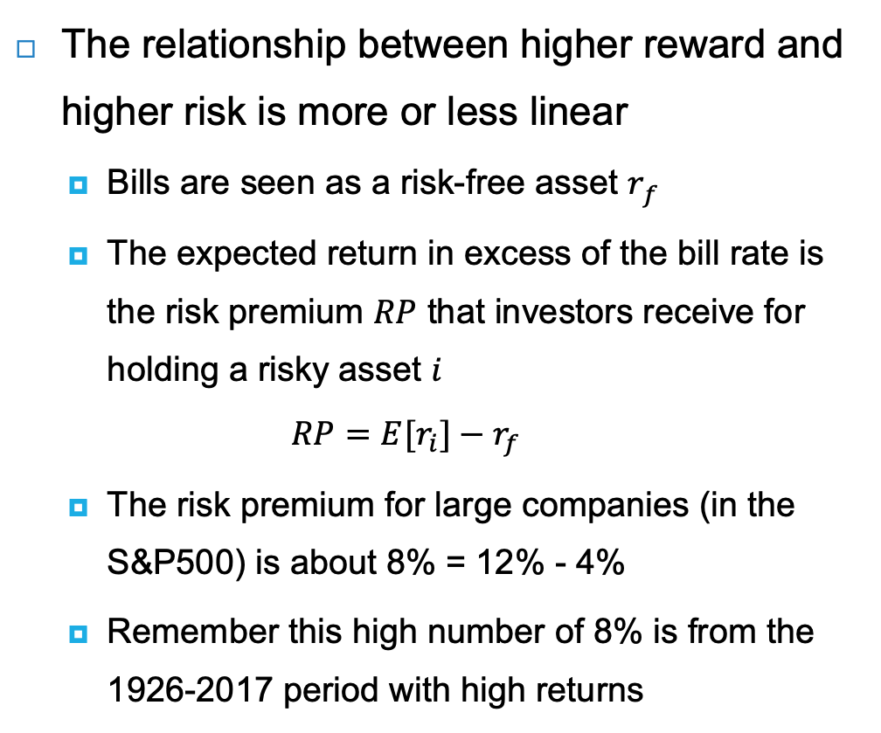
Historical returns and historical volatility
The relationship between higher reward and higher risk is more or less linear
  Bills are seen as a risk-free asset $r_{f}$
  The expected return in excess of the bill rate is the risk premium $RP$ that investors receive for holding a risky asset $i$
  $$RP={E[r}_{i}]−r_{f}$$
  The risk premium for large companies (in the S&P500) is about 8% = 12% - 4%
  Remember this high number of 8% is from the 1926-2017 period with high returns
Average annual returns and volatility for the United States, from 1926 to 2017
Source: Berk and DeMarzo (2020)

Slide 14
Stock performance vs. government bonds
US stocks have outperformed US bonds in every 30-year period since 1850
Neared zero in the Great Depression of the 1930s and the Global Financial Crisis of 2008-2009

Slide 15
Diversification of financial risk
To hedge against risk, an investor may want to diversify its stock holdings in an investment portfolio
  Classical example: hold stock in an umbrella company and in an ice cream company
The risk of fluctuating stock prices can be split into:
  Firm-specific risk (idiosyncratic risk): unique to the company and can be diversified in a portfolio
  Market risk (systematic risk): common to all companies and cannot be diversified
    Example of the business cycle: in a downturn almost all companies will have lower returns
    Only market risk is priced in financial markets, as systematic risk cannot be diversified away
How many stocks do you need for a diversified portfolio?
  Statman (2004) shows that a well-diversified stock portfolio needs to include just 50 to 100 stocks to eliminate firm-specific or idiosyncratic variance of stock returns

Slide 16
Diversification of financial risk
There are smaller benefits of diversification beyond those 100 stocks, but they are exhausted when the number of stocks surpasses 300 stocks
Standard deviation of portfolio
1.0
0.8
0.6
0.4
0.2
0
Firm specific risk
Market risk
0 50 100 150 200 250 300
Number of stocks in portfolio

Slide 17
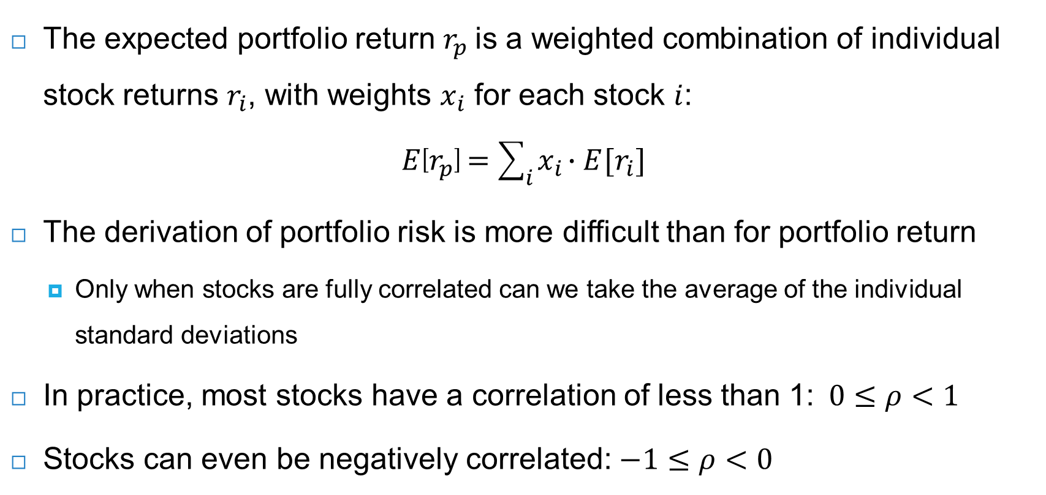
Portfolio return
The expected portfolio return $r_{p}$is a weighted combination of individual stock returns $r_{i}$, with weights $x_{i}$ for each stock $i$:
$$E\left[r_{p}\right]=\sum_{i}{x_{i}∙E[r_{i}]}$$
The derivation of portfolio risk is more difficult than for portfolio return
  Only when stocks are fully correlated can we take the average of the individual standard deviations
In practice, most stocks have a correlation of less than 1: $0≤ρ<1$
Stocks can even be negatively correlated: $−1≤ρ<0$

Slide 18
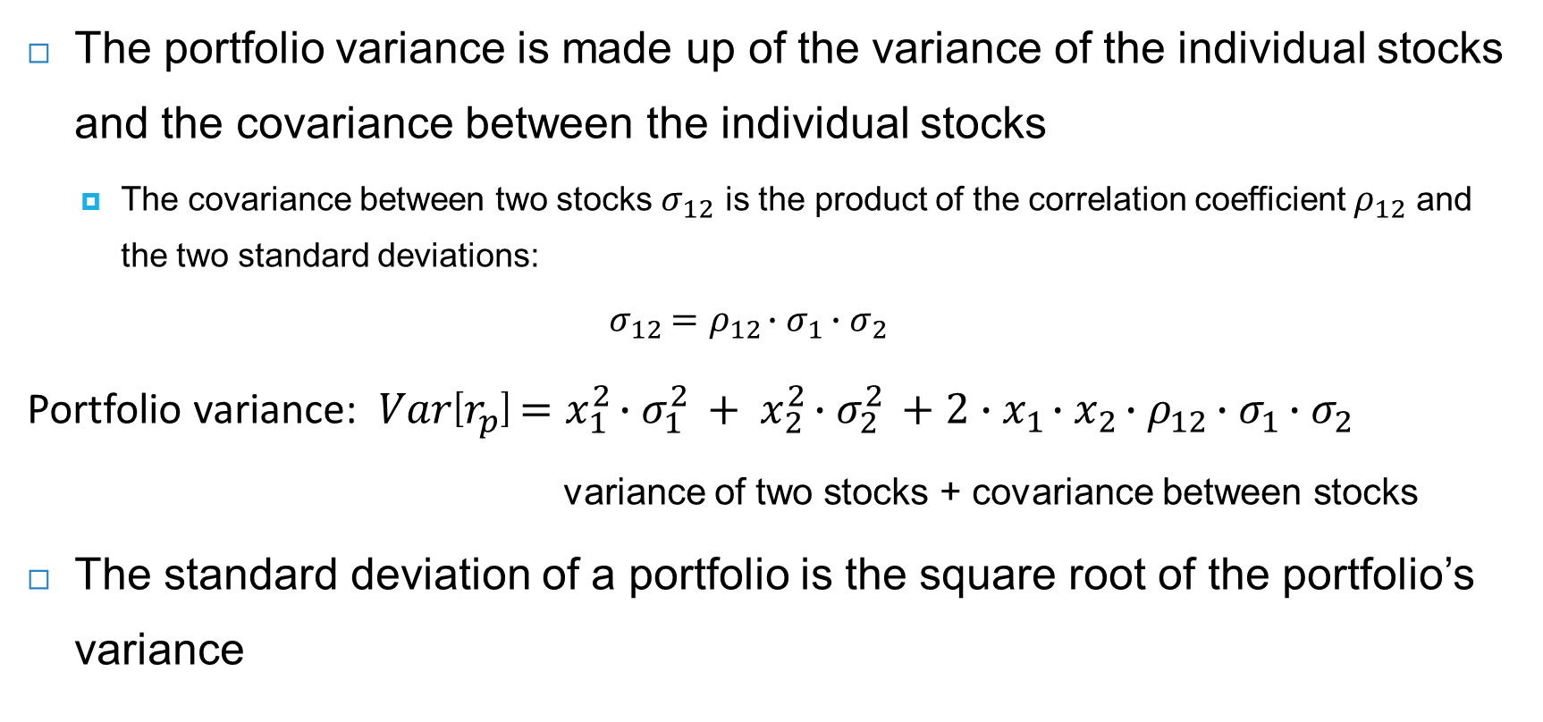
Portfolio variance
The portfolio variance is made up of the variance of the individual stocks and the covariance between the individual stocks
  The covariance between two stocks $σ_{12}$ is the product of the correlation coefficient $ρ_{12}$ and the two standard deviations:
  $$σ_{12}={ρ_{12}∙σ}_{1}{∙σ}_{2}$$
Portfolio variance: $Var\left[r_{p}\right]=x_{1}^{2}∙σ_{1}^{2} + x_{2}^{2}∙σ_{2}^{2} +2∙x_{1}∙x_{2}∙{ρ_{12}∙σ}_{1}{∙σ}_{2}$
variance of two stocks + covariance between stocks
The standard deviation of a portfolio is the square root of the portfolio’s variance

Slide 19

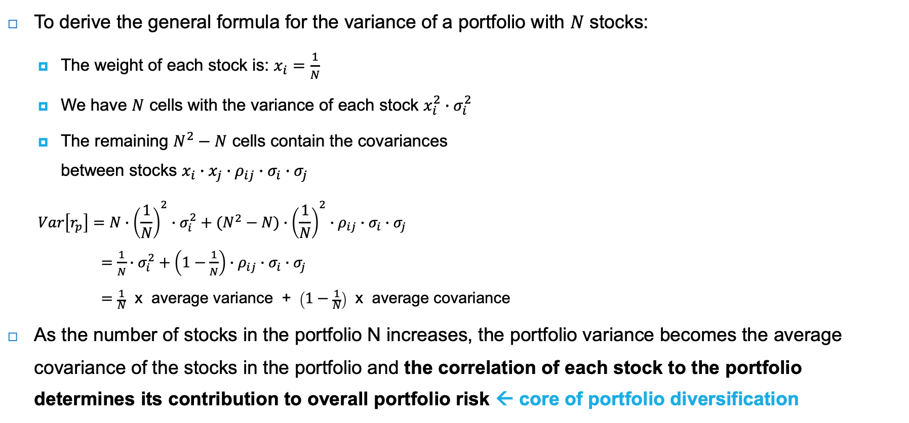
Variance of large portfolios
To derive the general formula for the variance of a portfolio with $N$ stocks:
  The weight of each stock is: $x_{i}=\frac{1}{N}$
  We have $N$ cells with the variance of each stock $x_{i}^{2}∙σ_{i}^{2}$
  The remaining $N^{2}−N$ cells contain the covariances
  between stocks $x_{i}∙x_{j}∙{ρ_{ij}∙σ}_{i}{∙σ}_{j}$
  $$Var\left[r_{p}\right]=N∙{\left(\frac{1}{N}\right)}^{2}∙σ_{i}^{2}+(N^{2}−N)∙{\left(\frac{1}{N}\right)}^{2}∙{ρ_{ij}∙σ}_{i}{∙σ}_{j}$$
  $=\frac{1}{N}∙σ_{i}^{2}+\left(1−\frac{1}{N}\right)∙{ρ_{ij}∙σ}_{i}{∙σ}_{j}$
  $=$ $\frac{1}{N}$ x average variance + $\left(1−\frac{1}{N}\right)$ x average covariance
As the number of stocks in the portfolio N increases, the portfolio variance becomes the average covariance of the stocks in the portfolio and the correlation of each stock to the portfolio determines its contribution to overall portfolio risk ← core of portfolio diversification
Stock
Stock |  | 1 | 2 | 3 | … | … | N
 | 1
 | 2
 | 3
 | …
 | …
 | N
$N=$shaded diagonal cells
Source: Adapted from Brealey, Myers, Allen and Edmans (2022)

Slide 20
Capital Asset Pricing Model (CAPM)
The risk-return measures and the principles of portfolio diversification provide the building blocks for the Capital Asset Pricing Model (CAPM)
CAPM assumes that diversification through combining risky stocks in a portfolio eliminates the firm-specific risk of individual stocks
An efficient portfolio is a stock portfolio whereby investors cannot increase return given the level of risk (volatility)

Slide 21
Efficient frontier
The efficient frontier is the combination of highest return portfolios for each volatility level
The capital market line shows the combinations of the efficient portfolio and the risk-free asset

Slide 22
Efficient frontier
The tangent portfolio provides the highest possible return for a given level of volatility of any (efficient) portfolio available
Assuming that investors have homogeneous expectations, all investors want to hold this tangent portfolio ← it becomes the market portfolio
A key insight of the CAPM is that all investors hold a combination of the risk-free asset and the market portfolio in equilibrium

Slide 23
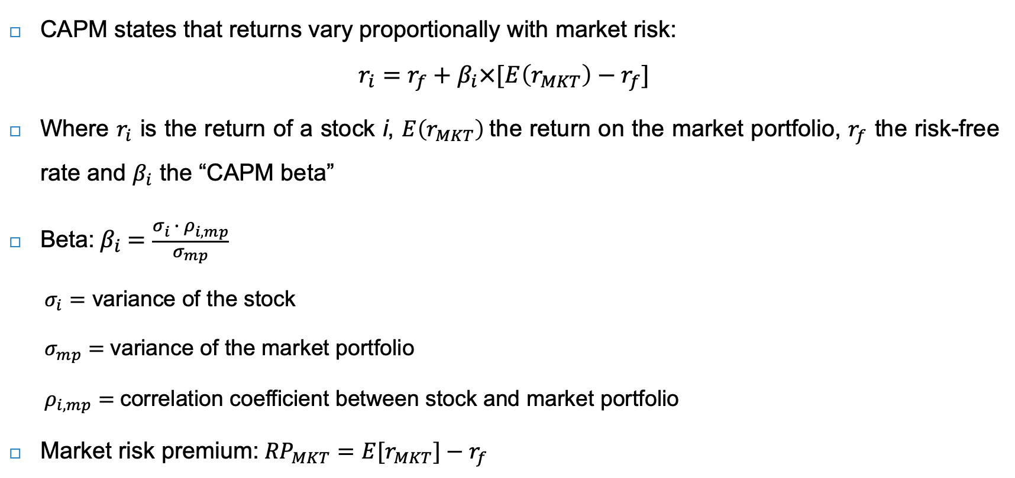
Capital Asset Pricing Model (CAPM)
CAPM states that returns vary proportionally with market risk:
$$r_{i}=r_{f}+β_{i}×[E\left(r_{MKT}\right)−r_{f}]$$
Where $r_{i}$ is the return of a stock i, $E\left(r_{MKT}\right)$the return on the market portfolio, $r_{f}$ the risk-free rate and $β_{i}$ the “CAPM beta”
Beta: $β_{i}=\frac{σ_{i} ∙ ρ_{i,mp}}{σ_{mp}}$
  $σ_{i}=$ variance of the stock
  $σ_{mp}=$variance of the market portfolio
  $ρ_{i,mp}=$correlation coefficient between stock and market portfolio
Market risk premium:${RP}_{MKT}={E[r}_{MKT}]−r_{f}$

Slide 24
Security market line (SML)
The security market line (SML) shows the graphic representation of the risk-return relationship by plotting the expected return against the beta of each stock or portfolio
The slope is the risk premium of the market portfolio

Slide 25
Limitations to measures of historical risk and return
Using backward-looking statistics, the implicit assumption is that the risk-return relationships remain the same in the future
Lucas (1976) basically argues that the structure of the historical relationships will change, when the nature of the assets changes due to policy changes
  Government policies (or stakeholder pressure) to address sustainability challenges may turn the tables on the stock market
  Profitable companies in the past may become stranded assets (oil & tobacco), while new companies providing solutions rise in value (e.g. Tesla with electric cars)

Slide 26
Limitations to measures of historical risk and return
There are severe limitations to the benchmarks used by investors (passive investing)
  Weightings of countries
    In 1900, the United Kingdom accounted for 24% of global stock market value, followed by the United States (15%), Germany (13%), France (11%) and Russia (6%)
    In 2021, the United States accounted for 56% of global stock market value, followed by Japan (7%), the United Kingdom (5%), China (4%) and France (3%)
  Weightings of sectors
    In 1900, rail made up over 60% of the US stock market, and almost 50% of the UK stock market
    In 2021, large sectors were technology, industrials, health, retail, banking and oil & gas
Today’s market index represents yesterday’s industry: old companies and industries are slowly fading out, while new companies and industries are added after much delay

Slide 27
Social and environmental risks
Stock prices react primarily to news about financial risks as reported by companies
There is less attention for other risk indicators, such as social and environmental risks
Just like financial (F) risk, social (S) and environmental (E) risks can be split into:
  Idiosyncratic risks: for example, water pollution by an individual company
  Systematic (systemwide) risks: for example, increased global temperature as a result of climate change
Sources of systematic risk

Slide 28
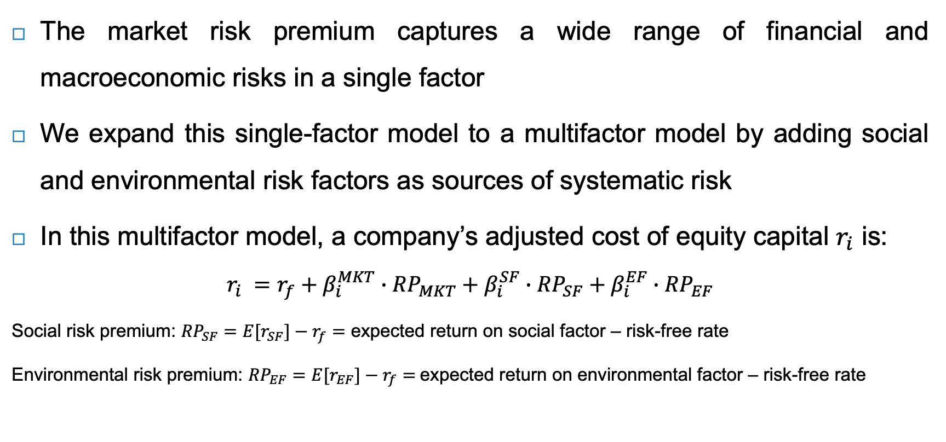
Multifactor model
The market risk premium captures a wide range of financial and macroeconomic risks in a single factor
We expand this single-factor model to a multifactor model by adding social and environmental risk factors as sources of systematic risk
In this multifactor model, a company’s adjusted cost of equity capital $r_{i}$ is:
$$r_{i} =r_{f}+β_{i}^{MKT}∙{RP}_{MKT}+β_{i}^{SF}∙{RP}_{SF}+β_{i}^{EF}∙{RP}_{EF}$$
Social risk premium: ${RP}_{SF}={E[r}_{SF}]−r_{f}=$ expected return on social factor – risk-free rate
Environmental risk premium: ${RP}_{EF}={E[r}_{EF}]−r_{f}=$expected return on environmental factor – risk-free rate

Slide 29
Social and environmental factor portfolios
How do we derive the social and environmental factor portfolios?
We can devise trading strategies that capture social risk and environmental risk respectively, which is not captured by the market portfolio
Based on the S(ocial) and E(nvironmental) pillar of companies’ ESG rating
ESG ratings summarise a company’s performance on environmental, social and governance issues, as measured by an ESG rating agency

Slide 30
Social and environmental factor portfolios
The environmental factor portfolio could be constructed with:
  A brown portfolio, which takes the bottom third of the E rating of a large index (i.e. S&P 500)
  A green portfolio, which takes the top third of the E rating of the same index
A trading strategy that takes a long position in the brown portfolio, which it finances with a short position in the green portfolio, produces the environmental risk premium
This portfolio which is long in brown stocks and short in green stocks is called the brown-minus-green (BMG) E portfolio
Similarly, a bad-minus-good (BMG) S portfolio uses the top third and bottom third of the S rating to capture the social risk premium

Slide 31
Challenges of the multifactor model
There are several challenges in the application of the multifactor model in practice:
  Constructing the social and environmental factor portfolios based on ESG ratings is challenging due to low ESG data quality
  Deriving social and environmental risk premiums from financial market data assumes the efficient markets hypothesis (EMH), arguing that stock prices incorporate all relevant information (Fama, 1970)
    EMH thus assumes that social and environmental risk is priced
    Instead, the adaptive markets hypothesis (AMH) argues that the degree of market efficiency depends on an evolutionary model of individuals adapting to a changing environment (Lo, 2004, 2017)

Slide 32
Environmental and social risk premiums
Summary of the findings on environmental and social risk premiums:
Type of risk premium | Annual risk premium | Period | Companies
Environmental risk premium
* broad environmental pillar | 1.2% - 1.9% | 2012-2020 | U.S.
* carbon risk premium | 3.6% - 4.6% | 2005-2018 | global
Social risk premium
* broad social pillar | N / A | N / A | N / A
* sin risk premium | 2.5% 2.8% | 1965-2006 1999-2019 | U.S. U.S.
Sources: Pastor, Sambaugh and Taylor (2022), Bolton and Kacperczyk (2023), Hong and Kacperczyk (2009) and Zerbib (2022)

Slide 33
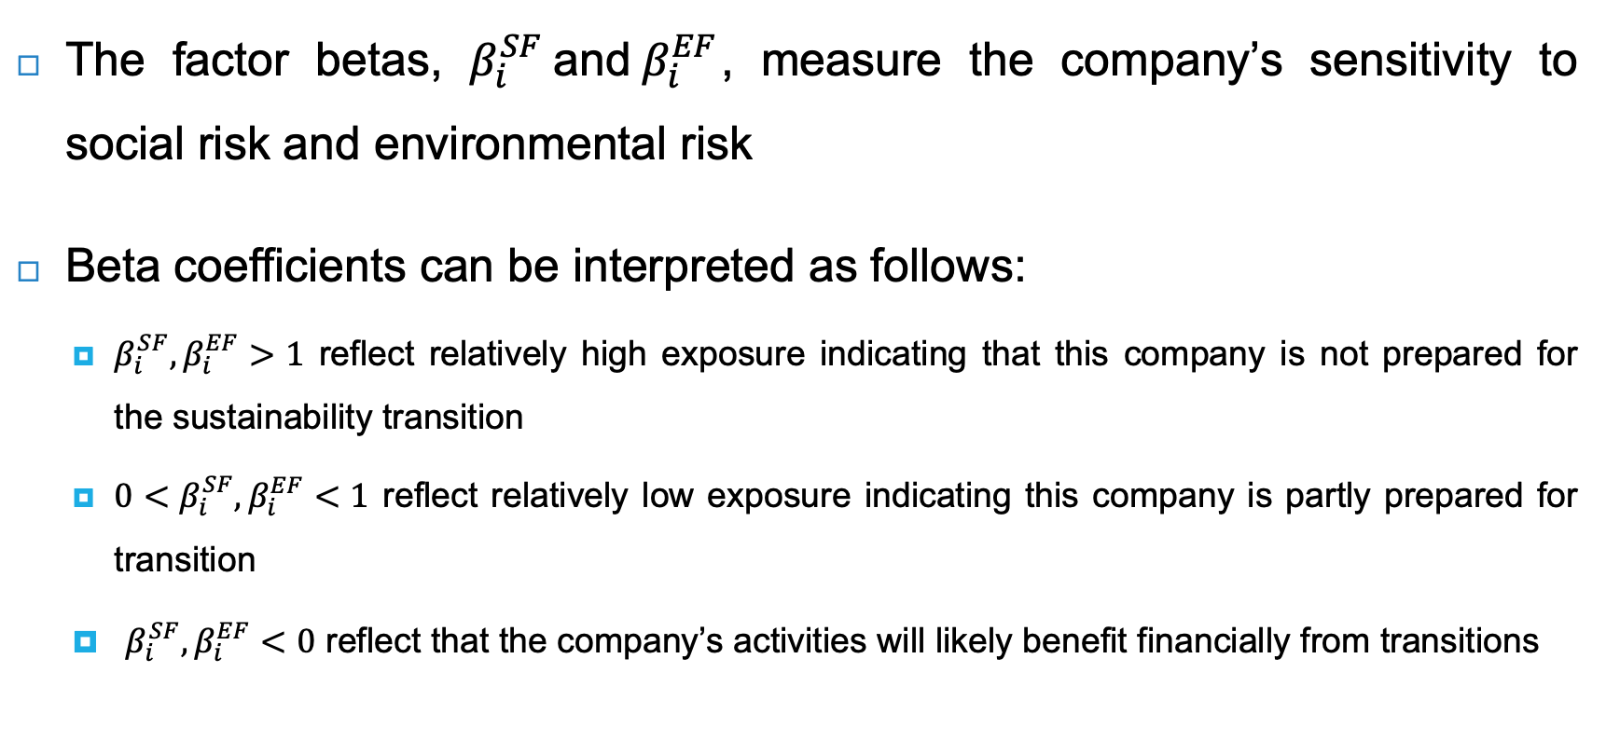
Factor betas
The factor betas, $β_{i}^{SF} \text{and} β_{i}^{EF}$, measure the company’s sensitivity to social risk and environmental risk
Beta coefficients can be interpreted as follows:
  $β_{i}^{SF}, β_{i}^{EF}>1$ reflect relatively high exposure indicating that this company is not prepared for the sustainability transition
  ${0<β}_{i}^{SF}, β_{i}^{EF}<1$ reflect relatively low exposure indicating this company is partly prepared for transition
  $β_{i}^{SF}, β_{i}^{EF}<0$ reflect that the company’s activities will likely benefit financially from transitions

Slide 34
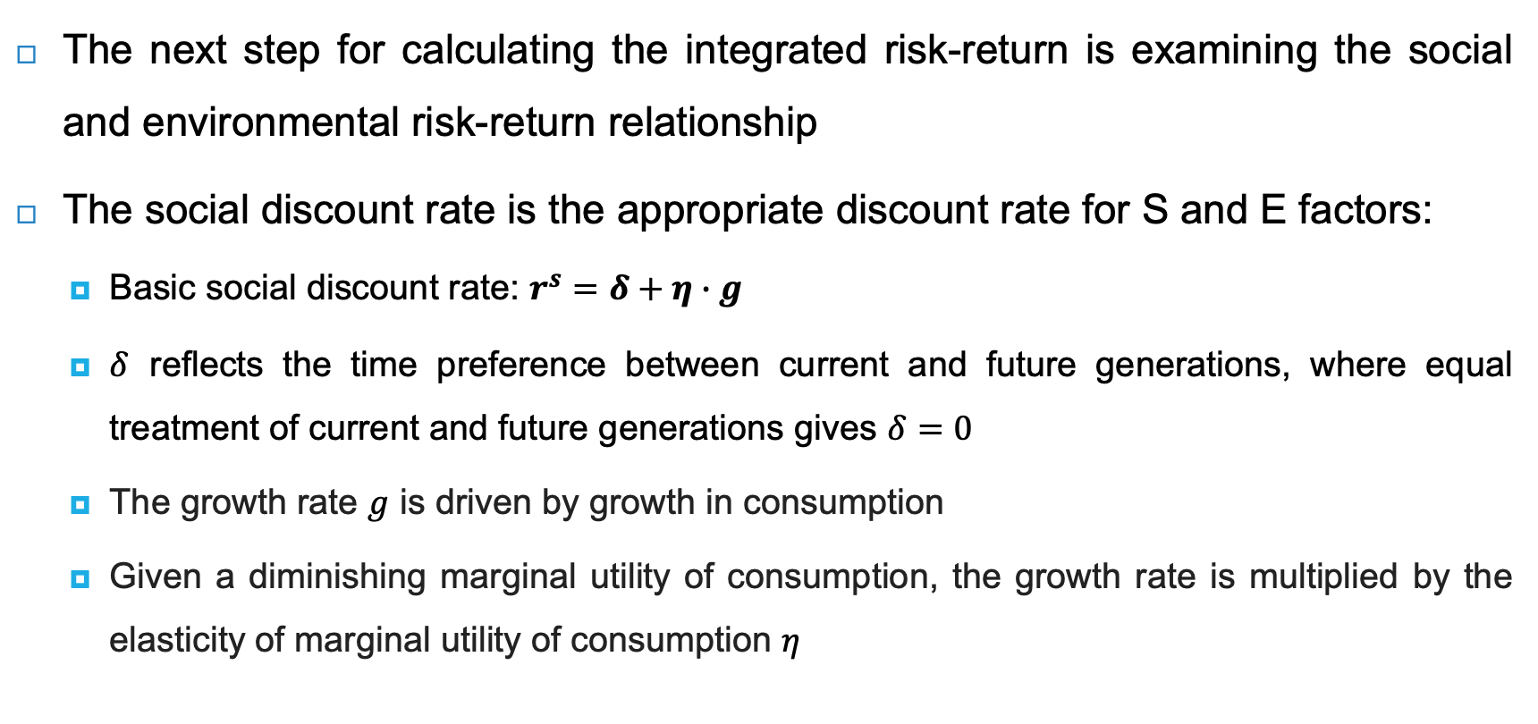
Social discount rate
The next step for calculating the integrated risk-return is examining the social and environmental risk-return relationship
The social discount rate is the appropriate discount rate for S and E factors:
  Basic social discount rate: $r^{s}=δ+η∙g$
  $δ$ reflects the time preference between current and future generations, where equal treatment of current and future generations gives $δ=0$
  The growth rate $g$ is driven by growth in consumption
  Given a diminishing marginal utility of consumption, the growth rate is multiplied by the elasticity of marginal utility of consumption $η$

Slide 35
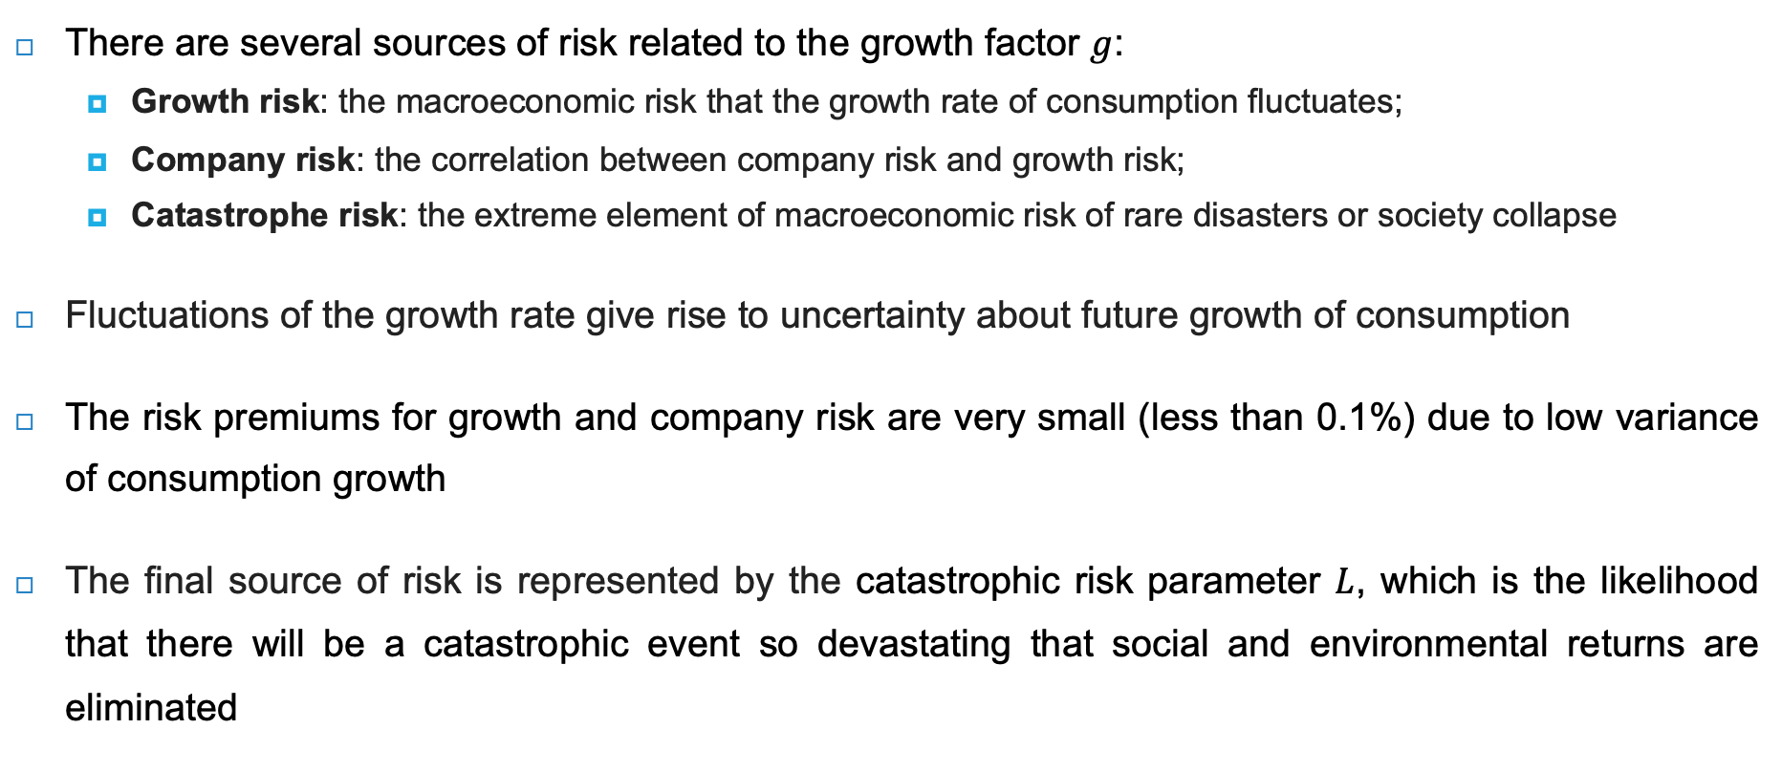
Risk & social discount rate
There are several sources of risk related to the growth factor $g$:
  Growth risk: the macroeconomic risk that the growth rate of consumption fluctuates;
  Company risk: the correlation between company risk and growth risk;
  Catastrophe risk: the extreme element of macroeconomic risk of rare disasters or society collapse
Fluctuations of the growth rate give rise to uncertainty about future growth of consumption
The risk premiums for growth and company risk are very small (less than 0.1%) due to low variance of consumption growth
The final source of risk is represented by the catastrophic risk parameter $L$, which is the likelihood that there will be a catastrophic event so devastating that social and environmental returns are eliminated

Slide 36
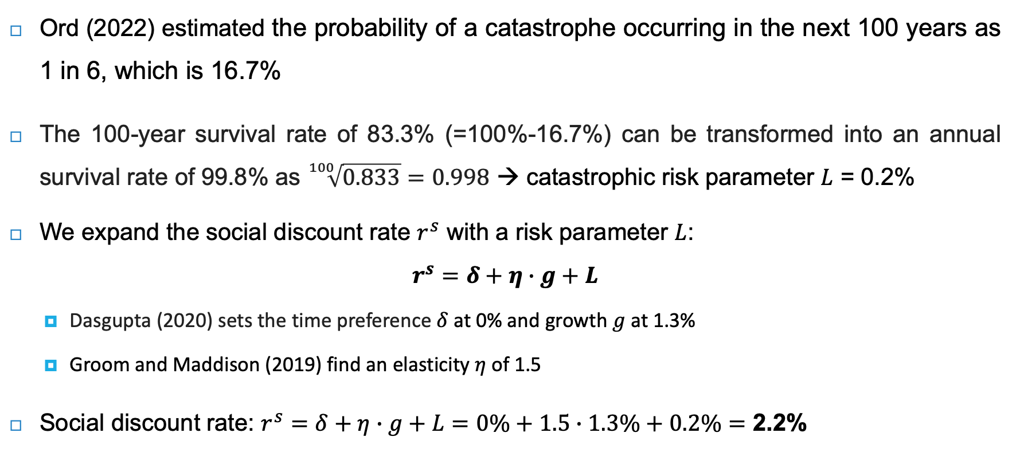
Estimating social discount rate
Ord (2022) estimated the probability of a catastrophe occurring in the next 100 years as 1 in 6, which is 16.7%
The 100-year survival rate of 83.3% (=100%-16.7%) can be transformed into an annual survival rate of 99.8% as $\sqrt[100]{0.833}=0.998$ → catastrophic risk parameter $L$ = 0.2%
We expand the social discount rate $r^{s}$ with a risk parameter $L$:
$$r^{s}=δ+η∙g+L$$
  Dasgupta (2020) sets the time preference $δ$ at 0% and growth $g$ at 1.3%
  Groom and Maddison (2019) find an elasticity $η$ of 1.5
Social discount rate: $r^{s}=δ+η∙g+L=0\%+1.5∙1.3\%+0.2\%=$ 2.2%

Slide 37
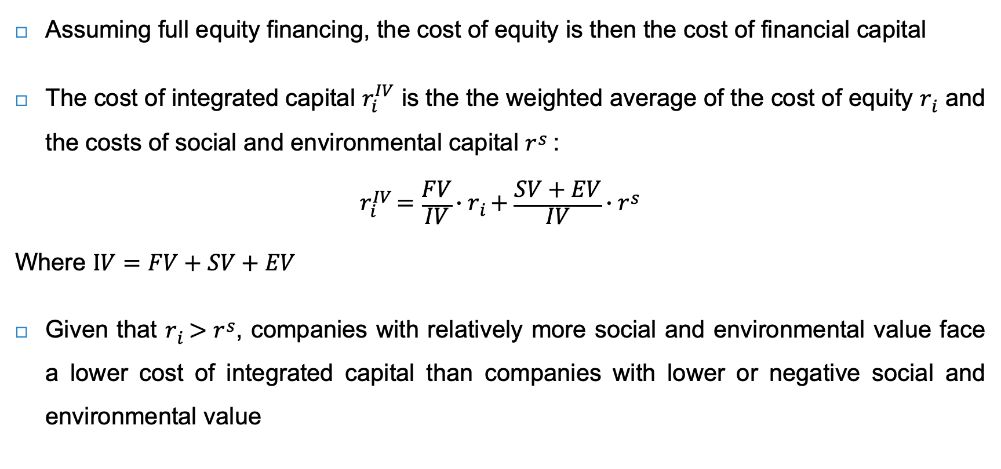
Estimating cost of integrated capital
Assuming full equity financing, the cost of equity is then the cost of financial capital
The cost of integrated capital $r_{i}^{IV}$ is the the weighted average of the cost of equity $r_{i}$ and the costs of social and environmental capital $r^{s}$:
$$r_{i}^{IV}=\frac{FV}{IV}∙r_{i}+\frac{SV+EV}{IV}∙r^{s}$$
Where $IV=FV+SV+EV$
Given that $r_{i}>r^{s}$, companies with relatively more social and environmental value face a lower cost of integrated capital than companies with lower or negative social and environmental value

Slide 38
Estimating cost of integrated capital
Problem
See below the cost of financial, social and environmental capital (left) and value dimensions (right) for an oil company and a medtech company:
What is the cost of integrated capital of the two companies?
Cost of capital | Oil company | Medtech company
Financial | 9.0% | 6.0%
Social | 2.2% | 2.2%
Environmental | 2.2% | 2.2%
Value dimension | Oil company | Medtech company
Financial value | 8 | 4
Social value | -1 | 3
Environmental value | -4 | -1
Integrated value | 3 | 6

Slide 39
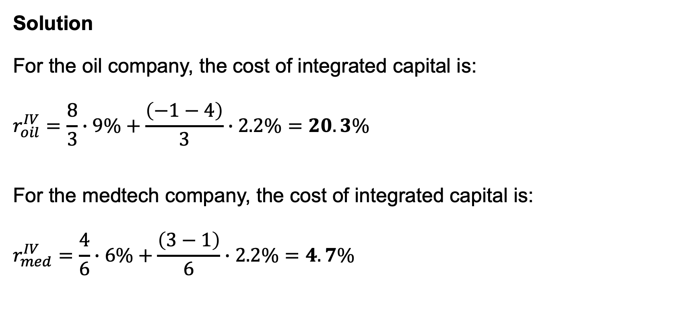
Estimating cost of integrated capital
Solution
For the oil company, the cost of integrated capital is:
$$r_{oil}^{IV}=\frac{8}{3}∙9\%+\frac{\left(−1−4\right)}{3}∙2.2\%=20.3\%$$
For the medtech company, the cost of integrated capital is:
$$r_{med}^{IV}=\frac{4}{6}∙6\%+\frac{\left(3−1\right)}{6}∙2.2\%=4.7\%$$

Slide 40
Forward-looking risk
Given the limitations of historical or backward-looking risk measures, it makes sense to develop forward-looking risk measures that takes transitions into account
Forward-looking risk measures tend to be of a more qualitative nature
  Methods: scenario analysis; options analysis; integrating forward-looking estimates

Slide 41
Scenario analysis
Scenario analysis is a process of analysing possible future events by considering alternative possible outcomes (also known as ‘alternative worlds’)
The scenario construction process requires choices on parameters:
  Time horizon: sufficiently long;
  Number and diversity of scenarios: 3 to 4 differing scenarios;
  Focal question: critical question that company (or investor) wants to address;
  Drivers of change: main clusters of risk;
  Impact on companies: translate scenarios into impact on companies;
  Probabilities of scenarios: assign probabilities to scenarios

Slide 42
Scenario matrix for climate risk
Physical risk
High
1) Hot house scenario
Rising temperatures
Rising sea level
Little action to avert
global warming
2) Too little, too late
Rising temperatures
Rising sea level
Late disorderly transition
Low
High
Transition risk
3) Orderly
Global warming limited
Timely policy response
to reduce emissions
4) Disorderly
Global warming limited
Sudden and unanticipated
policy response
Low

Slide 43
Quantifying the scenario analysis
Using expected values per transition scenario:
30% * $50 + 30% * $0 + 20% *
$40 + 20% * $60 = $35
For Inditex case study:
24% * €31.9 + 16% * €10.4 + 36%
* €22.5 + 24% * €28.4 = €24.2
 | No transition by 2030 | Transition by 2030
Company does not change | $50 (30%) | $0 (30%)
Company does position for transition | $40 (20%) | $60 (20%)
Inditex | No transition by 2030 | Transition by 2030
Company does not change | €31.9 (24%) | €10.4 (16%)
Company does position for transition | €22.5 (36%) | €28.4 (24%)

Slide 44
Strategy setting
Scenario outcomes can be used as input for the strategy setting
The company can increase its value by better preparing itself for transition, and thus avoid the costly collapse scenario
  Good management would take strategic action on its own initiative
  Investors can demand from the company that it prepares itself for transition in the process of engagement
If the company is not prepared to take action, investors may divest from the company as it is overvalued on the basis of the climate risk scenario analysis

Slide 45
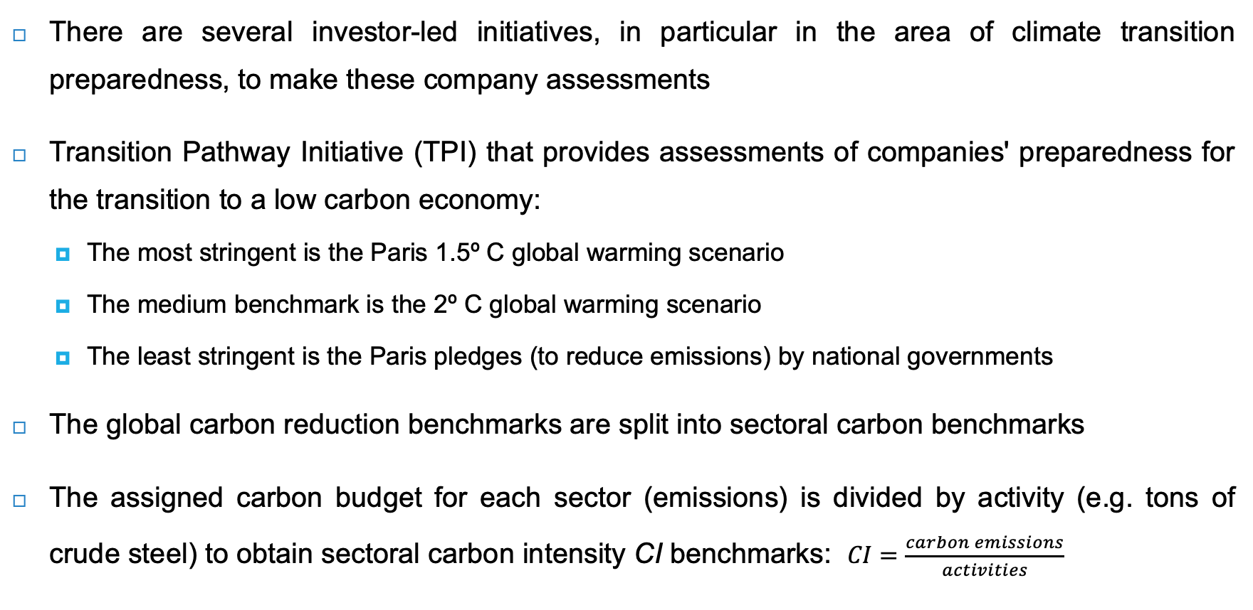
Transition pathways
There are several investor-led initiatives, in particular in the area of climate transition preparedness, to make these company assessments
Transition Pathway Initiative (TPI) that provides assessments of companies' preparedness for the transition to a low carbon economy:
  The most stringent is the Paris 1.5º C global warming scenario
  The medium benchmark is the 2º C global warming scenario
  The least stringent is the Paris pledges (to reduce emissions) by national governments
The global carbon reduction benchmarks are split into sectoral carbon benchmarks
The assigned carbon budget for each sector (emissions) is divided by activity (e.g. tons of crude steel) to obtain sectoral carbon intensity CI benchmarks: $CI=\frac{carbon emissions}{activities}$

Slide 46
Transition pathways
Plotting a company carbon reduction pathway against the benchmarks checks whether a company is Paris-aligned, and thus prepared for transition
Not prepared for transition
Becoming prepared for transition
Prepared for transition

Slide 47
Conclusions
A company’s risk can be split into systematic or market-wide risk; and idiosyncratic risk, which can be diversified away in a portfolio
The Capital Asset Pricing Model (CAPM) states that in equilibrium, all investors hold a combination of the risk-free asset and the market portfolio
Historical risk-return analysis has a limited capacity for assessing future financial risk
We expand the single market model of the CAPM into a multifactor model by adding social and environmental factors (as sources of systematic risk)
The cost of integrated capital gives corporate managers the tool to make an integrated risk-return assessment in their investment decisions

